Slide 1
ASTRA
SMART LEDGERS
January 6, 2011

Slide 2
Agenda
What is a Ledger?
SMART Ledgers
Control, Default, & Optional Budgets
Updating Ledgers
Reconciling Budgetary Expenses to Actuals
Encumbrance Dashboard

Slide 3
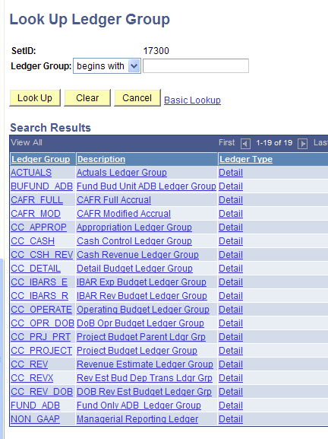
What is a Ledger?
An accounting book of final entry where transactions are listed in separate accounts .
The General Ledger
Commitment Control Ledgers

Slide 4
Commitment Control Ledgers
Referred to as “KK” Ledgers
Used in budget checking
Stores an agency’s budget
“Saves” transaction details if budget check is successful

Slide 5
General Ledger:
Known as the “Actuals” ledger
Records accounting entries from sub-modules
Official book of record for the State of Kansas
Modified Accrual Basis of Accounting

Slide 6
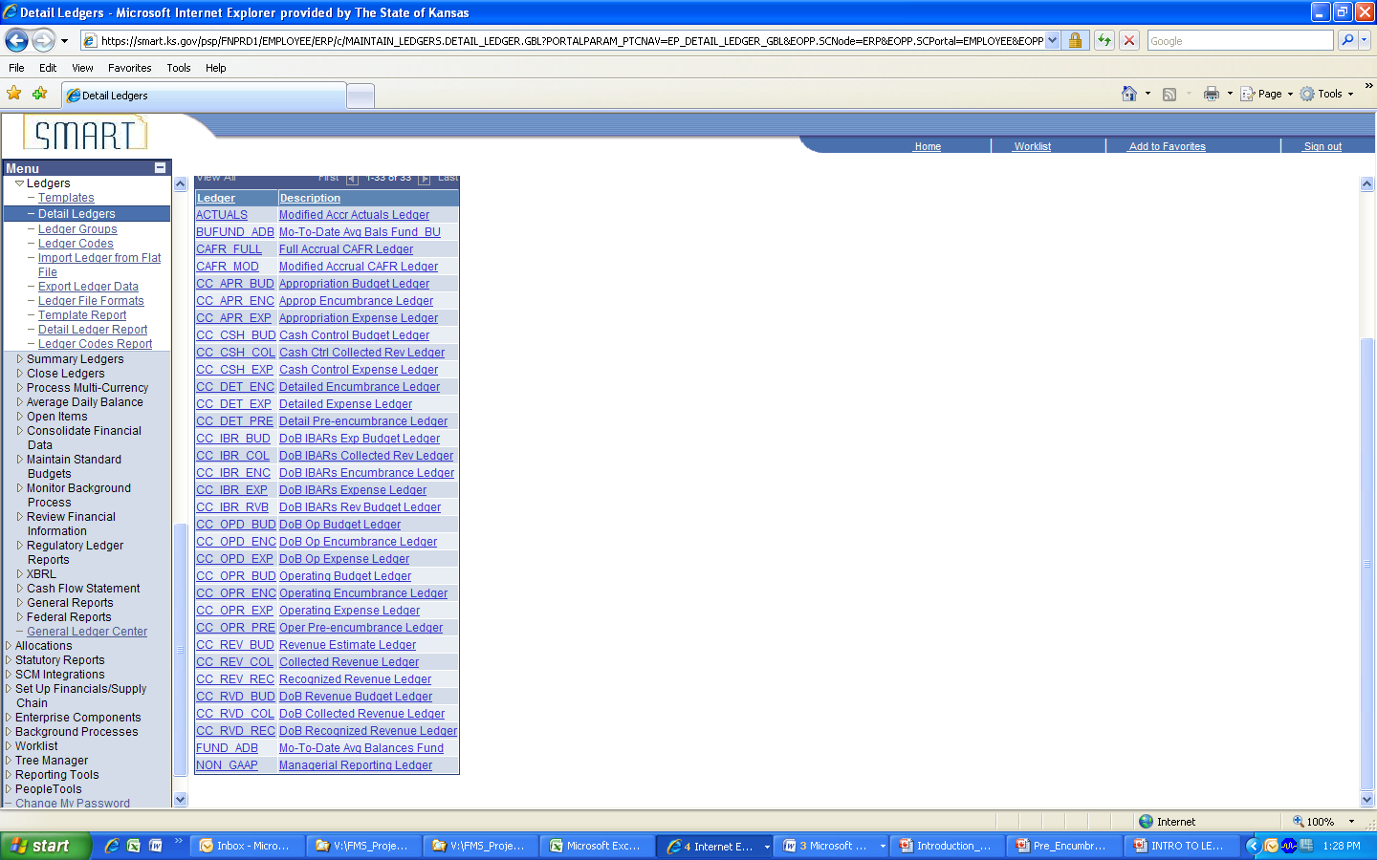
Detail Ledgers:
Two types:
Expense
Revenue
Check out our suffixes!

Slide 7

Expense Ledger Types
Ledger Type | Suffix | Purpose
Budget | BUD | Stores the budget used in budget checking. The budget is set up at the beginning of the fiscal year and remains fairly static throughout (unless there are legislative actions that impact the budget)
Encumbrance | ENC | PO processing
Expense | EXP | Expense processing

Slide 8
Revenue Ledger Types
Ledger Type | Suffix | Purpose
Collected | COL | Cash has been deposited
Estimated | EST | Estimated revenue expected for the period
Recognized | REC | Revenue that has been recorded but not yet physically received as cash

Slide 9
Control Budgets
CC_APPROP (Appropriation Budget)
CC_CASH (CashControl Budget)

Slide 10
Appropriation Ledger Group
Highest level of budget
Key chartfields include Department (All Agency rollup), Fund, Budget Unit, Account (All Expenses rollup)
Interfaced from IBARS & centrally managed
Spending authority granted by the legislature
Will fail transactions for exceeding dollar limit or invalid Fund/Budget Unit combination
No limit funds will have a budget of $999,999,999,999
CC_APPROP
(Appropriation)
CC_APR_BUD
CC_APR_ENC
CC_APR_EXP

Slide 11
Cash Control Ledger Group
Notice that there is no “ENC” encumbrance ledger
Encumbrances do not impact the cash control budget
Cash budget is not associated with a calendar, thus eliminating the need to transfer cash between fiscal years.
Initial budget will be STARS unexpended cash balance as of 6/18/2010.
Final budget will be the STARS unexpended cash balance as of the close of FY10. This will be loaded on 7/17/2010.
CC_CASH
(Cash Control)
CC_CSH_BUD
CC_CSH_EXP

Slide 12

CC_CASH Formula
Beginning Cash Balance
+ Revenue Collected – Expenses =
Available Cash Balance

Slide 13
Default Budgets
CC_OPR_DOB (Default Operating)
CC_REV_DOB (Default Revenue Estimate)
CC_DETAIL (Default Detail)

Slide 14
CC_OPR_DOB
Default Operating Budget
Interfaced from IBARS
Agency maintained through online budget journal entry and/or budget journal spreadsheet upload.
Track w/o budget
Annual Calendar
Key chartfields: Department (All Agency roll-up), Fund, Budget Unit, Program (DoB roll-up), Account (Category roll-up)

Slide 15
CC_REV_DOB
Default Revenue Estimate
Interfaced from IBARS
Agency maintained through online budget journal entry and/or budget journal spreadsheet upload.
Track w/o budget
Annual Calendar
Key ChartFields: Department (All Agency roll-up), Fund, Account (Intermediate roll-up)

Slide 16
CC_DETAIL
Default Detail Budget
Does not contain a budget ledger
Tracks expenses and encumbrances at the detailed transaction level
Annual Calendar
Key ChartFields: Department ID, Fund, Budget Unit, Program, Account, Service Location, Agency Use, PC Business Unit, Project ID, Activity, & Source Type

Slide 17
Optional Budgets
CC_OPERATE (Agency Operating)
CC_PROJECT (Agency Project)
CC_REV (Agency Revenue)

Slide 18
Agency Operating Ledger Group
Track budget issues warnings for exceeding budget but allows transaction to pass
Agency managed/entered through online budget journal entry and/or budget journal spreadsheet upload
Key ChartFields: specific to an agency
CC_OPERATE
(Agency Operating)
CC_OPR_BUD
CC_OPR_ENC
CC_OPR_EXP

Slide 19
Agency Project Ledger Group
Track budget issues warnings for exceeding budget but allows transaction to pass
Agency managed/entered through online budget journal entry and/or budget journal spreadsheet upload
Key ChartFields: specific to an agency
CC_PROJECT
(Agency Project)
CC_PRJ_BUD
CC_PRJ_ENC
CC_PRJ_EXP

Slide 20
Agency Revenue Estimate Ledger Group
Agency managed/entered through online budget journal entry and/or budget journal spreadsheet upload
Monthly Calendar
Key ChartFields: specific to an agency
CC_REV
(Agency Revenue Estimate)
CC_REV_BUD
CC_REV_REC
CC_REV_COL

Slide 21
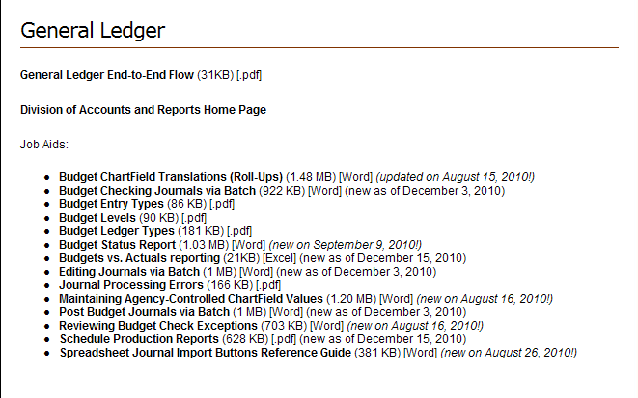
Additional Resources on
SMART Ledgers
Job Aids are available on the SMART website:
http://www.da.ks.gov/smart/Training/CourseMaterials/WBT/resources.html

Slide 22
Updating Ledgers
Budget Check vs. Posting

Slide 23
Transaction Process Flow
Budgetary control is enforced on financial transactions through the use of commitment control ledgers and control options.
Distribution Lines from Transactions
Journals – GL
Purchase Orders –PO
Vouchers – AP
Commitment Control
Ledgers
Actuals Ledger
Budget Checking
Process
Journal Posting Process
Budgets
Encumbrances
Expenses
Revenue Estimates
Revenue
Assets
Liabilities
Fund Equity
Revenue
Expenses

Slide 24
Posting to Commitment Control Ledgers
SMART AP
B
U
D
G
E
T
C
H
E
C
K
SMART TE
Commitment Control Ledgers (LEDGER_KK)
Accounting Entries
SMART AR
SMART PO
SHaRP
PAYROLL

Slide 25
Transaction Process Flow
Budgetary control is enforced on financial transactions through the use of commitment control ledgers and control options.
Distribution Lines from Transactions
Journals – GL
Purchase Orders –PO
Vouchers – AP
Commitment Control
Ledgers
Actuals Ledger
Budget Checking
Process
Journal Posting Process
Budgets
Encumbrances
Expenses
Revenue Estimates
Revenue
Assets
Liabilities
Fund Equity
Revenue
Expenses

Slide 26
Posting to the GL
Post Process
Accounting Entries
Journal Generator
Journal
Entries
Journal Post Process
General Ledger (Actuals)
Voucher Post
AR Update
Payment Post

Slide 27
Reconciling Budgetary Expenses to Actuals
Reconciling differences are the result of process timing and transactions that have not been fully processed
Posting Processes occur during the nightly batch; Budget Check is run during daily batches and on demand
Queries are in development to identify transactions that have passed budget check but aren’t yet posted
GL Exp + Bud Check/Not Posted Trx = Bud Exp

Slide 28
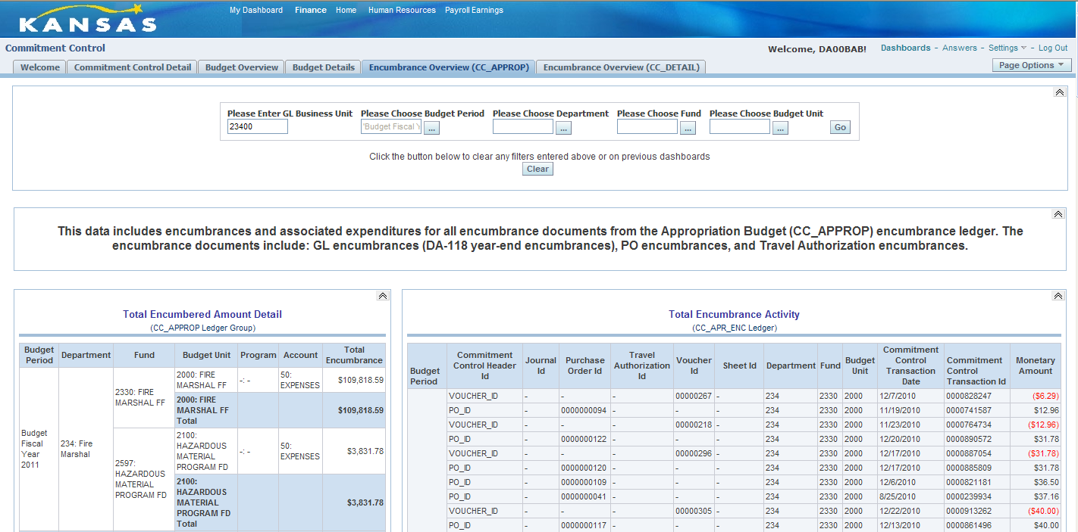
Encumbrance Dashboard
Now Available

Slide 29
Budget Reports/Inquiries
Budget Status Report (GLS8020)
Budget Details Inquiry

Slide 30
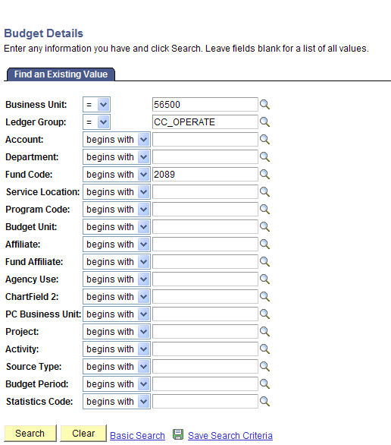
Budget Details Inquiry
Navigation: Commitment Control > Review Budget Activities > Budget Details
Narrow your search by entering as many parameters as is known/appropriate
Don’t enter ChartFields that are not budget keys
Do enter ChartFields at the correct budget translation

Slide 31
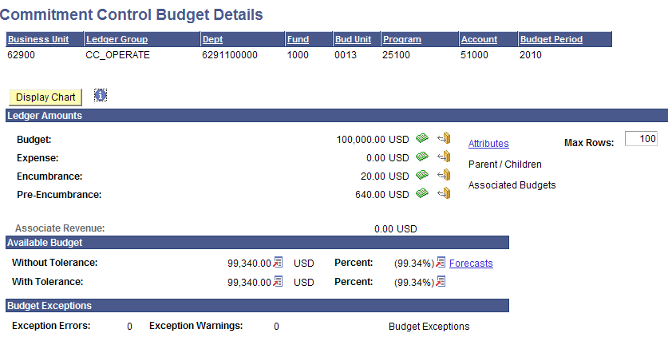
Budget Details Inquiry
Corresponding Ledgers
CC_OPR_BUD
CC_OPR_EXP
CC_OPR_ENC
If there are budget exceptions, a link will appear here

Slide 32
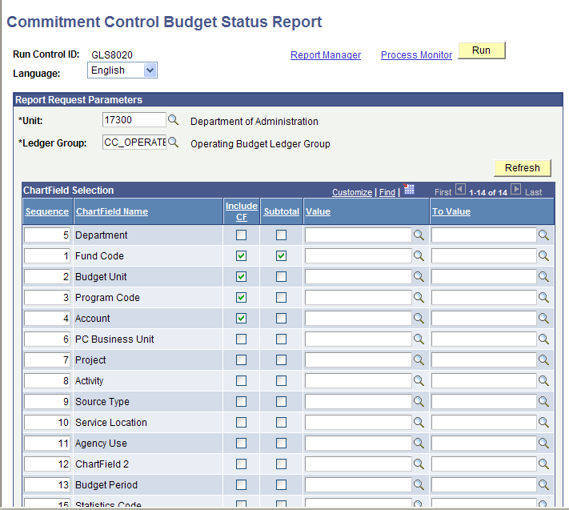
Budget Status Report
GLS8020
Navigation: Commitment Control > Budget Reports > Budget Status
Select the proper Ledger Group for the budget structure you wish to report against
Don’t select ChartFields that are not budget keys
Pay attention to the sort order (sequence) of the ChartFields you have selected to include

Slide 33
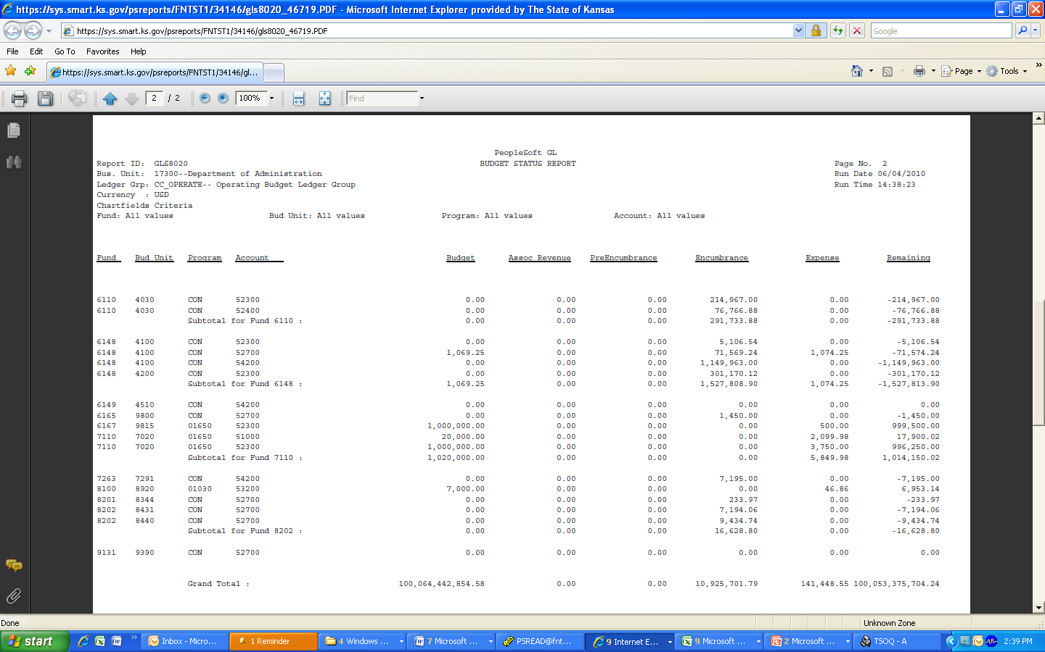
Budget Status Report
GLS8020

Slide 34
Questions?

