Slide 1
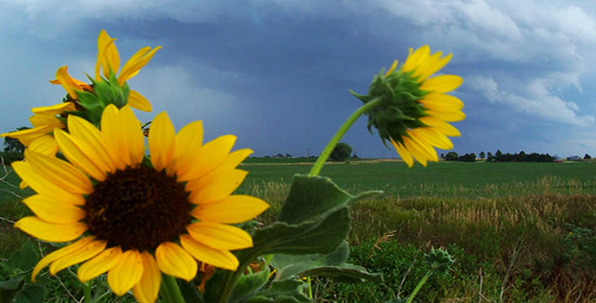
2011 GL Encumbrances
FYE Overview
Presented by Brett Bauer

Slide 2

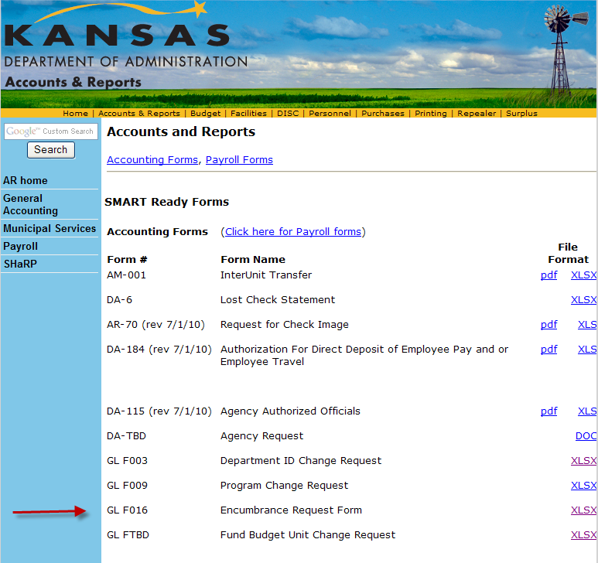
GL Encumbrance Request Form
GL F016
Available on A&R’s website:

Slide 3
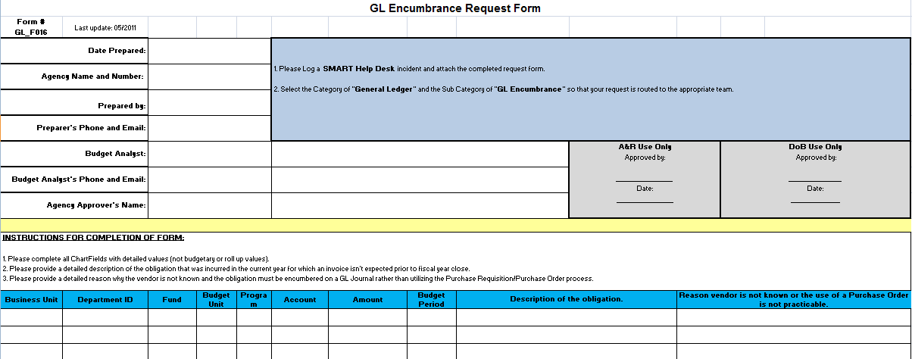
Encumbrance Request Form
Must provide a description of the obligation and the reason the vendor is not known or the Purchase Requisition/Order process is not practical for encumbering funds.

Slide 4
GL Encumbrance Process
Complete request form and attach it to a Help Desk Ticket by 5:00 p.m. on 7/6/2011.
Requests will be routed to the Division of the Budget (DoB) for Approval.
Upon DoB approval, the GL Journals will be created by A&R staff.
Agencies will be notified via the Help Desk of the Journal ID(s) or DoB’s denial.

Slide 5
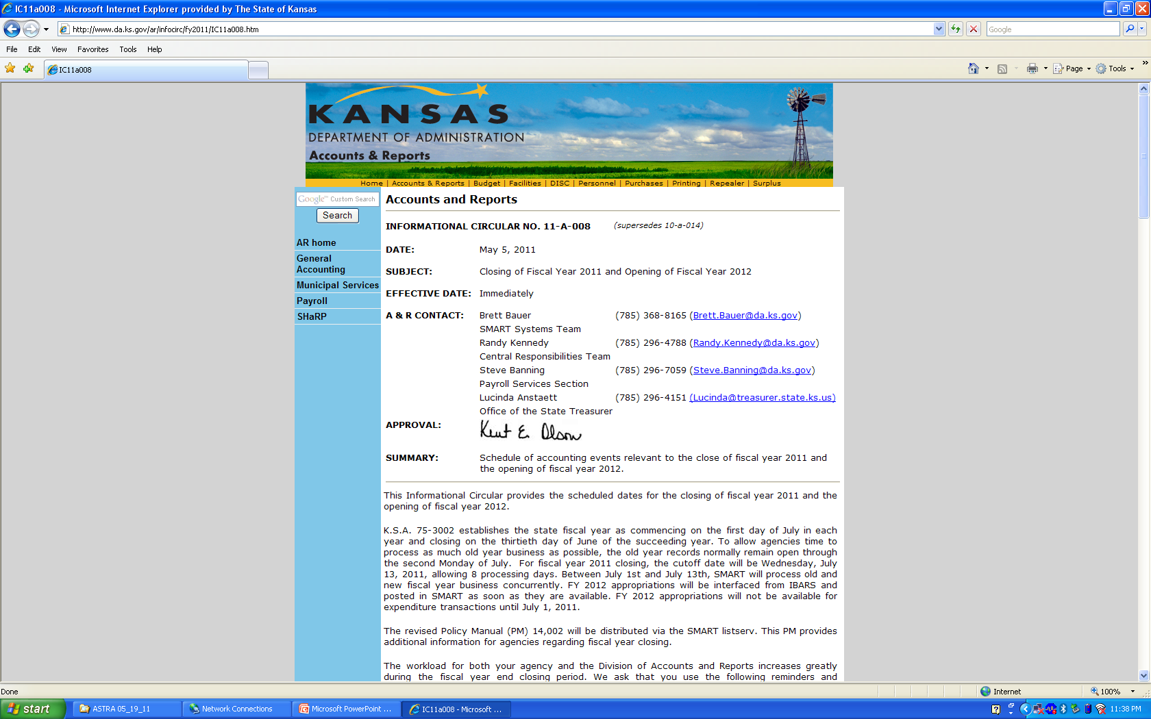
Preparing for Year End
Review Informational Circular No. 11-A-008 for important processing dates and deadlines.

Slide 6
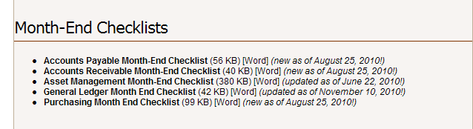
Preparing for Year End
Consult the Month-End Checklists in the Training section of the SMART website:

Slide 7
Concurrent Processing
June and July periods will both be open from July 1 – July 13.
Must change accounting date to 6/30/2011 in order to post transactions against fiscal year 2011.
Budget date must be 7/1/2010 – 6/30/2011 to affect budget period 2011 balances.
July 13 – last day to process fiscal year 2011 transactions.
July 14 - 17 – SMART open to Central users ONLY

Slide 8
Questions?

