Slide 1

Year End Reporting
Presented by: Natalie Zeller

Slide 2
Year End Reporting
Appropriation balances for appropriated funds as well as funds that have a legislative imposed spending limitation.
Cash balance for non appropriated funds.
Pending items that need to be posted to the GL
Next fiscal year’s Chart of Accounts.

Slide 3
Appropriations
You should only be concerned with your appropriation balance if the fund is an appropriated fund or a fund with a legislative imposed spending limitation.
Appropriations are stored only in Commitment Control.
Can be viewed in a report format or as an online inquiry.

Slide 4
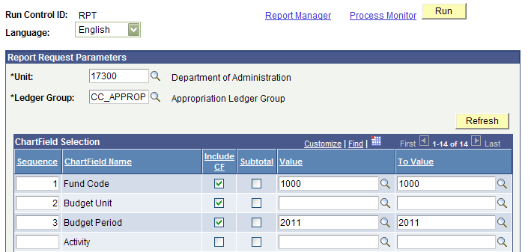
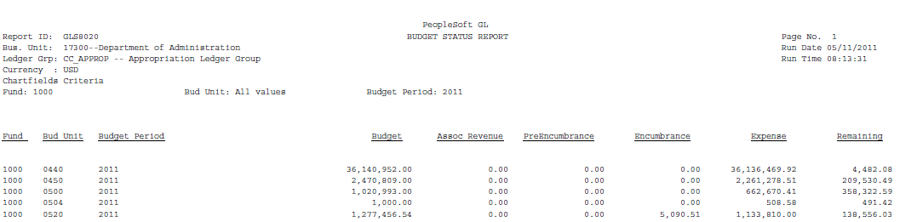
Appropriations
Report: GLS8020 – Budget Status Report
  Commitment Control > Budget Reports > Budget Status

Slide 5
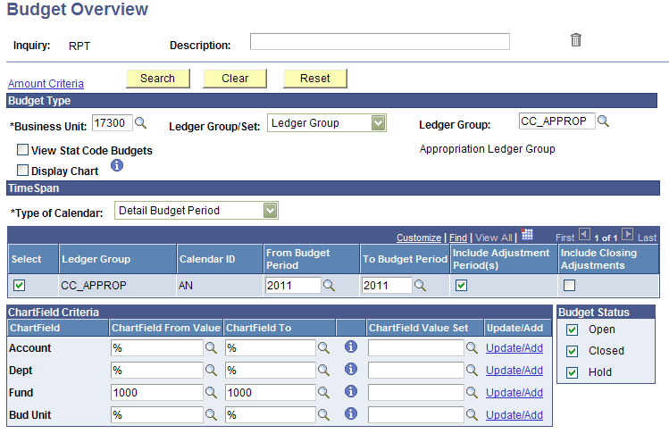
Appropriations
Inquiry: Budget Overview
  Commitment Control > Review Budget Activities > Budget Overview

Slide 6
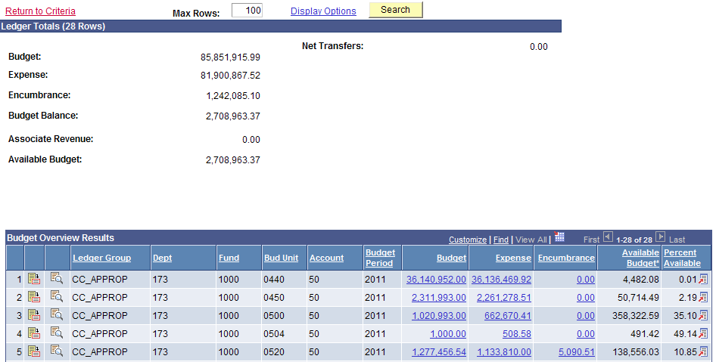
Appropriations

Slide 7
Cash
You should not be concerned with cash on any appropriated fund.
All non appropriated funds must have a positive cash balance before the close of the fiscal year.
There are a couple reports to monitor cash.
  KGL00001-Cash Balance Report
  KGL00005-Trial Balance by Fund

Slide 8
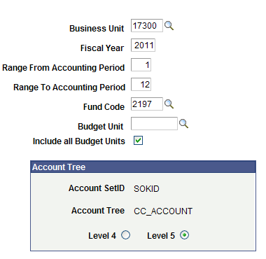
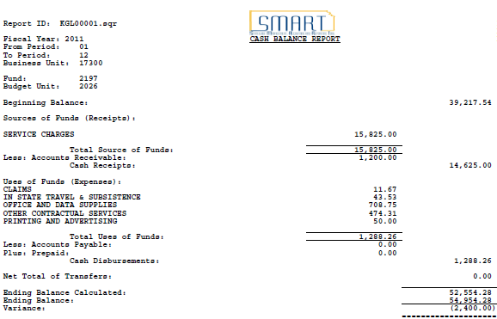
Cash
Report: KGL00001Cash Balance Report
  General Ledger > General Reports > Cash Balance Report

Slide 9
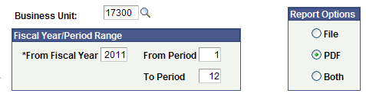
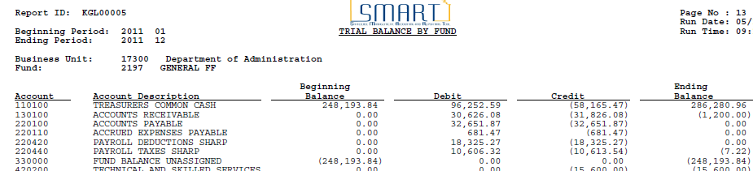
Cash
Report: KGL00005 Trial Balance by Fund
  General Ledger > General Reports > Trial Balance by Fund

Slide 10
Things Not Posted
Before year end close, you need to have everything posted to the GL that you wish to process in FY 2011.
There are three queries that display any items that have been budget checked but not posted to the GL.
  KS_AP_VOUCHERS_NOT_POSTED
    (Does not include interfunds)
  KS_EX_RPT_NOT_POSTED
  KS_GL_JRNLS_NOT_POSTED
  KS_APAR_PENDING_INTRFNDS

Slide 11
Balancing Commitment Control to ACTUALS
Formula: Commitment Control (for all budget years) – Budget Checked but not Posted = ACTUALS
Run either KS_KK_EXPENSE_DETAIL or KS_KK_EXP_ENC_DETAIL for all valid budget periods for your agency.
Run the three Not Posted queries and subtract from the KK query.
Run KS_GL_ACTUALS_EXP_BY_FUND_BU.

Slide 12
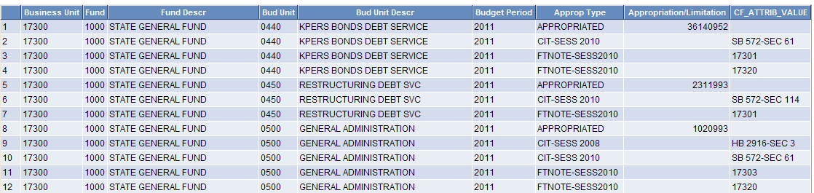
Chart of Accounts
Once the FY2012 budgets have been uploaded from Ibars, and the Central Responsibilities team has complete the Appropriation process, you can view your FY2012 Chart of Accounts.
KS_CHART_OF_ACCOUNTS

Slide 13
Questions?

