Slide 1


Bank of America Merchant Services
ASTRA Meeting
The State of Kansas
Shirley Davis, Relationship Manager
JD Wilks, Technical Relationship Manager
Melinda Speer, Strategic Account Executive
May 17, 2012

Slide 2
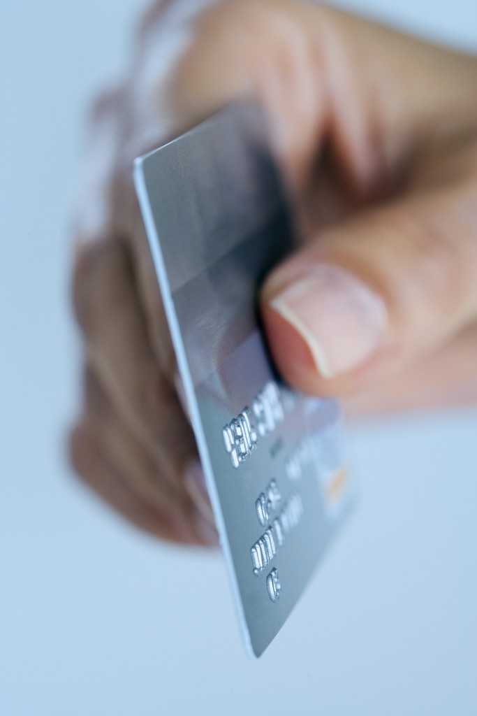
Agenda
Introductions
Who We Are
Contract Announcement
Product Offerings
New Product Offering
Adding Card Payments To Your Agency
Q/A
Next Steps
Notes:
₂

Slide 3

The Bank of America Merchant Services Dedicated Team

Slide 4
Dedicated Team
Relationship Manager
Shirley Davis
Manages overall relationship and promotes strategic partnership. Grows the business by partnering with our clients and listening to short and long term goals.
  Advise on new product solutions
  Interchange analysis to manage expenses and downgrades
  Engages appropriate business partners
  Primary contact for pricing, competitive bids, contract negotiations
  Consult on PCI and Chargeback Management
  Communication (business reviews, card association updates, webinars, and newsletters)
Technical Relationship Manager
JD Wilks
The Technical Relationship Manager works closely with your Relationship Manager to offer proactive consultation regarding payment technologies and platforms, share pertinent industry data, and identify new ways to build electronic payment programs that satisfy citizen demand and meet your business objectives.
Account Manager
Sheryl Levers
Assist with day to day merchant needs.
Strategic Account Executive
Melinda Speer, Merchant Services
Works with the Relationship Manager to identify product needs and implement new solutions.
Bank of America Team
Marilyn Bush, Sr. Client Manager
Terry Endres, Treasury Services Officer
Client Management Team dedicated to your banking relationship at Bank of America.
Notes:
₄

Slide 5
Who We Are

Slide 6

Expertise in a broad scope of industry segments
Government
Retail
Business-to-Business
Restaurant
Petroleum
Healthcare
Auto Dealers
Lodging and Casinos
Travel and Entertainment
Supermarket
6

Slide 7


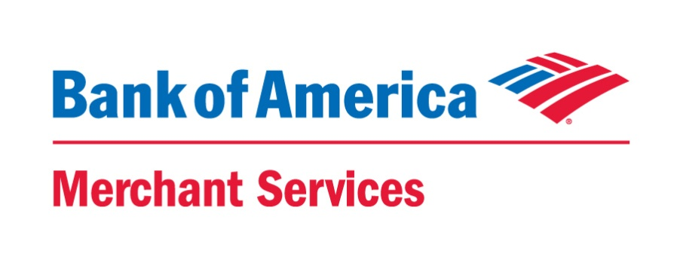

A Powerful Partnership
Geographic Footprint = 6,000+
Banking Centers
Brand Strength
Client Relationships
Best-in-Class Sales & Customer Support
Broad and Most Innovative
Product Portfolio
Leading Technology Platforms
Client Relationships
Best-in-Class Sales & Customer Support
Industry-leading Products
World-class Technology Solutions
Expansive Geographic Footprint
380,000* Merchant Relationships
12.9 Billion* Transactions Annually
6
Notes:
₇

Slide 8
State Contract

Slide 9
Contract Features and Benefits
5-Year Initial Term
Interchange Plus Pricing – Fixed Costs
Special Pricing On Optional Products/Services
  Point of Sale Devices
  Gateway Options
  Software Options
  Add Hoc Product and Services
Dedicated Account Management Team
Please refer to handouts for specific information on these options.
Notes:
₉

Slide 10
Terminals and point-of-sale solutions features and benefits
 | Features | Benefits
Terminals | Broad range of available terminals — wireless, touchscreen, built-in high-speed printers, portable, WiFi connectivity, and more | The ability to choose the perfect solution for your needs — and adapt when your needs change
Peripherals | PIN-pads and contactless readers | Enhances your customers’ payment experience and integrates easily with existing countertop terminals and integrated POS solutions
Virtual terminals and PC solutions | Allows any PC to become a point-of-sale device Affordable PC-based purchasing card software for credit and gift card | Enables you to process transactions from any location Provides the desirable payment vehicles that increase likelihood of customer purchases
Distribution and payment options | Partners with TASQ, the largest provider of POS equipment in America Industry-leading POS inventory, deployment, repair and service Flexible payment options for equipment and software | Assures the choices and options that work best for your business Confidence in equipment, installation and service Affordable options for your business
10

Slide 11
Appendix

Slide 12

First Data Global Gateway API
Integrated eCommerce capabilities for virtually any website
Key features
 | Supports all major card types and business-to-business Level II card transactions Supports alternative payments including Google Checkout™, PayPal®, eBillme™ and Amazon Payments™ Merchant retains complete control of the look and feel of merchant’s website Compatible with multiple programming languages
Key benefits
Intelligent | Cost savings: Minimal upfront costs and reduced payment processing costs Incremental revenue: Increased revenue potential via alternative payment options
Innovative | Integration: Seamlessly integrate payment functionality
Fast | Flexibility: Option to schedule recurring payments as needed
Secure | Reduced risk: Lower interchange rates by implementing MasterCard Secure Code™ and Verified by Visa fraud prevention tools
Competitive advantage
 | The eCommerce payment solution that seamlessly integrates with your website, enabling you to grow your business and reduce processing costs.
12
Notes:
ECA is our POS solution and our flagship product. Makes check payments as quick and easy to process as credit cards.
After the MICR is captured, check is returned to customer. Protects their personal information and reduces merchant’s labor tied to check processing.

Slide 13
First Data Global Gateway Connect
Simplified, hosted solution adds payment functionality to a website.
Key features
 | Hosted online payment solution Several development options available for varying business/IT needs Supports all major card types and business-to-business Level II card transactions Recurring payments functionality, plus emailed receipts and order confirmation
Key benefits
Intelligent | Cost savings: Minimal upfront costs and reduced payment processing costs Incremental sales: Increased revenue per customer per visit
Innovative | Easily enables eCommerce on merchant websites
Fast | Accepts multiple payment types
Secure | Reduced Risk: We host the payment processing, ensuring that customer data is secure by accommodating the latest compliance standards.
Competitive advantage
 | The quick and easy way to add payment capabilities to your website, while reducing the risk associated with payment acceptance.
13
Notes:
ECA is our POS solution and our flagship product. Makes check payments as quick and easy to process as credit cards.
After the MICR is captured, check is returned to customer. Protects their personal information and reduces merchant’s labor tied to check processing.

Slide 14
First Data Global Gateway Virtual Terminal
Internet-based transaction processing solution
Key features
 | Full transaction processing – credit/debit/check Support for all major card types Easy-to-use interface requires minimal training Fraud prevention tools
Key benefits
Intelligent | Cost savings: Minimal upfront costs and reduced payment processing costs Incremental sales: Increased revenue per customer per visit
Fast | Reduced ongoing maintenance: Eliminates need for software installations, upgrades and system maintenance
Innovative | Access: Complete transactions from any internet-ready PC
Secure | Reduced risk: Bank of America Merchant Services maintains cardholder data
Competitive advantage
 | Turns any PC with an internet connection into a point-of-sale (POS) terminal for virtually any location.
14
Notes:
ECA is our POS solution and our flagship product. Makes check payments as quick and easy to process as credit cards.
After the MICR is captured, check is returned to customer. Protects their personal information and reduces merchant’s labor tied to check processing.

Slide 15
Adding Card Payments To Your Agency

Slide 16
Adding Card Payments To Your Agency
Complete the sign in sheet.
Contact Connie Schuessler at The State procurement office.
Contact Shirley Davis at shirley.davis@bankofamericamerchant.com or call at 617-524-1490.
  A meeting will be scheduled with your agency to understand your goals and objectives.
  Recommendations on next steps will be provided at this time.
12

Slide 17
TeleCheck® Overview

Slide 18
A look at the distribution of non-cash payments
24.5 billion
checks paid
75% of non-cash payments involve DDA access.
Source “2010 Federal Reserve Payments Study,” Federal Reserve
Bank of America Merchant Services
18
Notes:
Why do people still write checks?
Habit
Pay now – not later
Receipt/record keeping
High dollar transactions
Bill payments
Want the float (delay in payment)
Don’t have access to debit or credit
86% use money orders or checks!
18

Slide 19


Comprehensive paper and electronic payments portfolio
Paper check services
Paper Check Acceptance Mail order/ COD Hold check Check cashing
ECA® Payment on Account CONNECTPAYSM
Lockbox Pro21SM eDeposit
Internet Check Acceptance Remote Pay
Checks by PhoneSM
Authorization
Settlement
ACH from point of sale
Mail or back office
Collections
Web
Phone
Bank of America Merchant Services
19
Notes:
19

Slide 20
TransArmor® Solution
Multi-layered Data Security

Slide 21
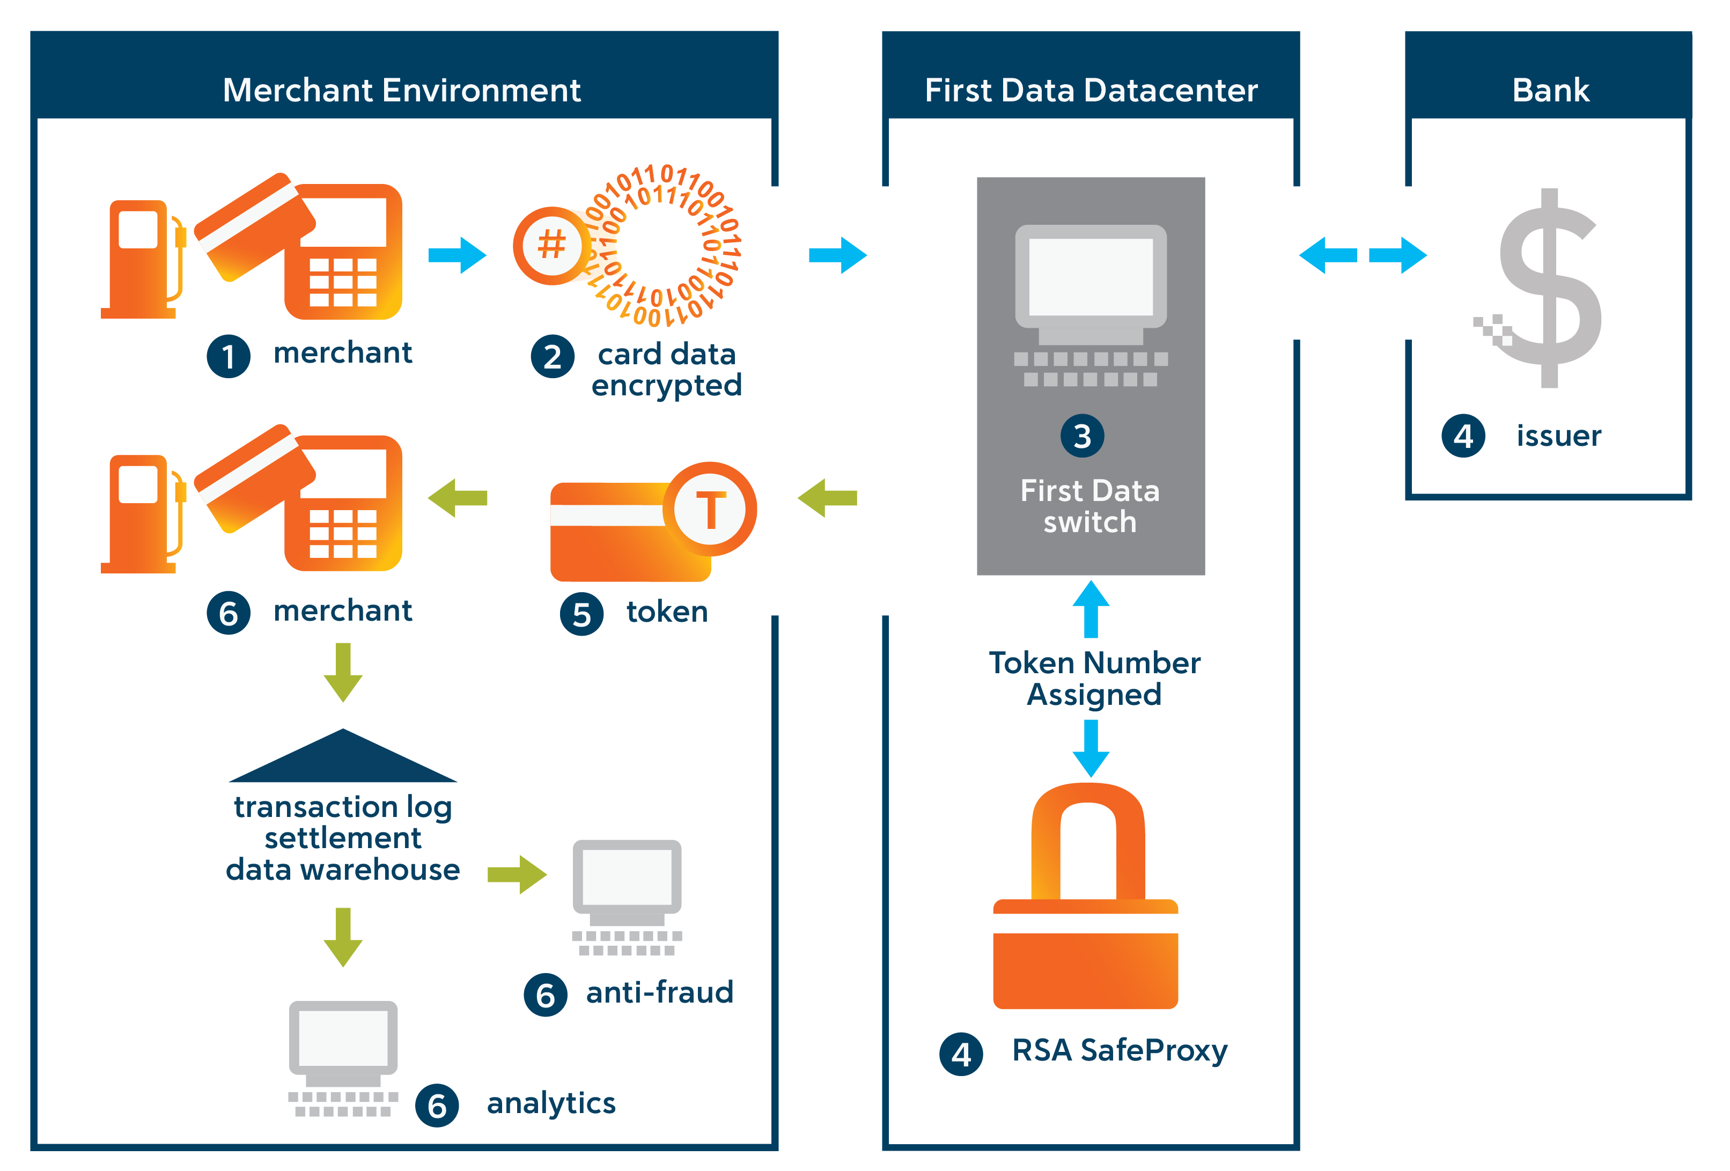
How does TransArmor® Solution work?
This solution is a unique combination of encryption, which protects sensitive payment card data in-transit, and tokenization, which safely stores card data post-authorization.
Consumer presents card to merchant.
Card data is encrypted and transmitted to our front end.
Our front end decrypts the data payload.
Card data is sent to issuing bank for authorization and, in parallel, is tokenized.
Token is paired with authorization response and sent back to the merchant.
Merchant stores token instead of card data in their environment and uses token for all subsequent business processes.
Bank of America Merchant Services
21
Notes:
21

Slide 22
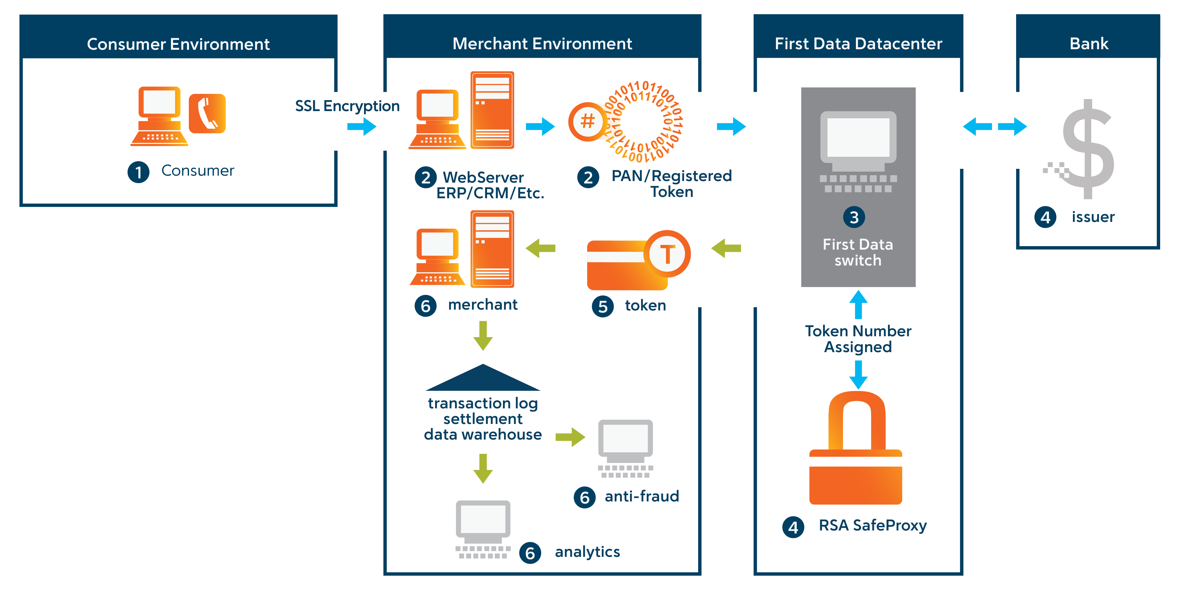
How does TransArmor® Solution work for Card-Not-Present (CNP)?
Card data is keyed into payment page/IVR. If e-Wallet technology is used, a consumer token can be used to initiate a new transaction.
Personal account number (PAN) is encrypted using session encryption and sent to us.
Encrypted session is received at our datacenter.
Card number is passed to bank for authorization and SafeProxy server for tokenization.
Authorization and multi-pay token are returned to the merchant.
Multi-pay token is stored in place of the card number in all places.
New financial transactions, including sales, adjustments, refunds and settlement use the multi-pay token instead of the PAN.
Bank of America Merchant Services
22
Notes:
22

Slide 23
Appendix

Slide 24
TeleCheck® Appendix

Slide 25
eCheck is an economical alternative to other payment options.
Average merchant processing cost for $40 POS ticket
Warranted eCheck
Source: First Data analysis
Bank of America Merchant Services
25

Slide 26
Market-leading payments expertise
Why TeleCheck®?
372,000 subscribing locations
Process 1.8 million transactions daily
Information on 98% of check writers
Electronic processing volume =
Top 5 bank
Tenured staff with deep market knowledge
Continued investment in technology and innovation since 1965
Pioneer of ACH solutions for merchant payment environments
    Point of sale
    Web
    Alternative form factors
Authorization
Settlement
End-to-End
Solution
Collections
Bank of America Merchant Services
26
Notes:
26

Slide 27
Typical transaction authorization flow
TeleCheck merchant check from customer
Second hour
verification
Invalid
ID validation
Approval
Negative and early warning databases
Risk scoring/
operational rules
Activity
databases
Decline
Decline
Bank of America Merchant Services
27
Notes:
27

Slide 28
Risk management service levels
 | Warranty | Verification
Service description | Approved payments will receive guaranteed funding from TeleCheck. | TeleCheck does negative database check and optional risk management review before issuing an approve/decline response.
Cash flow | 48-hour funding¹ for approved payments | 48-hour funding¹ with variations based on returns
Reconciliation | Streamlined – similar to credit cards | Greater complexity due to returns cycle
Collections services | Yes | Optional
Bad check losses | TeleCheck absorbs | Merchant absorbs
¹Funding occurs on second banking day after transaction is processed by TeleCheck.
Bank of America Merchant Services
28
Notes:
28

Slide 29
Risk management philosophy
Segmentation
Partnership
Real-time action
Targeted treatment of:
Customer populations
Store populations
Product segments
Enables you to take appropriate case-by-case action.
Constant communication between:
The merchant
Certified fraud examiners
Law enforcement
Works closely with law enforcement to address fraud.
Continual monitoring:
Observing fraud patterns
Determining appropriate steps
Real-time responses
Keeps a watchful eye so you can focus on your business.
Bank of America Merchant Services
29
Notes:
29

Slide 30

The TeleCheck difference: settlement
Unprecedented volume
  Continued enhancement since 1998
  Trusted with more than $79 billion annually
Eliminating the processing headaches
  ACH eligibility determination
  Prevent and resolve exceptions
  Administrative return resolution
  Dramatic streamlining of merchant
  accounting and reconciliation processes
Client funding in two banking days
Source: TeleCheck 2011 data.
Settlement
Authorization
Settlement
End-to-end solution
Collections
Bank of America Merchant Services
30

Slide 31

How TeleCheck settlement works
Monday
Tuesday
Wednesday
Merchant
Bank
1
2
3
Merchant sends transactions
to TeleCheck by
9:00 p.m. CST.
TeleCheck creates and scrubs ACH file, sends file to bank.
Consumer checking account is debited; merchant is credited for payment amount and receives detailed
funding report.
Bank of America Merchant Services
31

Slide 32
A closer look at settlement
What’s eligible for electronic conversion?
Convert automatically — about 98% of checks
Convert with setup changes (drop to draft)
Can’t convert
today
Corp checks (contain
auxiliary on-us field)
Money orders
Personal checks
under $25k
(ACH banks)
Temporary checks
Payroll/
government
Business checks
under $25k
(without
auxiliary on-us field)
Personal checks
(non-ACH banks)
Other¹
¹ Check types that can’t be converted to ACH: U.S. Treasury/Federal Reserve, travelers, third-party, credit card, line of credit, cashiers, non-U.S. banks, amounts > $25,000.
Bank of America Merchant Services
32
Notes:
32

Slide 33
Spotlight on ACH administrative returns handling
 | TeleCheck | Competition
Transactions | 100,000 | 100,000
Average check Amount | $60 | $60
Check volume | $6,000,000 | $6,000,000
Admin returns | $4,200 | $18,000
Admin return rate | .07% | .30%
Admins not warranted Merchant loss | $ 0 | $ 1,800
A “hidden” competitive advantage
What is an administrative return?
  A non-bankable item – bank can’t
  locate account number or it’s
  invalid/doesn’t exist
  Often fraud
  When not fraud, occurs due to MICR
  misreads, parsing or conversion errors
How TeleCheck prevents
administrative returns
  Effective MICR parsing, business rules
  and logic – learned through 10-plus years experience
  Our admin return rate is industry-leading
Compare with competition – TeleCheck ECA merchants experience no losses
due to administrative returns.
Bank of America Merchant Services
33
Notes:
33

Slide 34
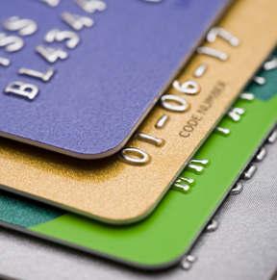
Industry trends
78% of breaches focused on stealing payment card data in 2010.¹
In 2010, the average cost of coping with a data breach rose to $214 per compromised record.²
Merchants have spent more than $1 billion on
PCI DSS compliance.³
PCI compliance requires significant and ongoing effort,
and is no guarantee of security against a breach.
¹ Verizon, 2011 Data Breach Investigations Report, Verizon Business RISK Team in cooperation with the U.S. Secret Service, 2010
² Ponemon Institute, LLC, 2010 Annual Study: U.S. Cost of a Data Breach, March 2011
³ Letter to Bob Russo of the PCI Security Standards Council from the National Retail Federation, et. al., June 9, 2009.
Bank of America Merchant Services
34
Notes:
34

Slide 35
Storing card data is valuable.
Many merchants use — or would like to use — transaction data to:
Run business processes such as recurring payments, returns or voids.
Understand consumer buying behavior for valuable marketing and
loyalty programs.
Storing card data is also risky.
Loss of data due to a breach can have a profound effect on a
merchant business.⁴
Brand damage and loss of customer trust and loyalty
Ongoing compliance effort and costs to maintain systems, resources, etc.
Fines from regulatory entities
Legal costs
Financial institution costs
Business disruption and inability to deliver products and services
⁴ The True Cost of Compliance, A Benchmark Study of Multinational Organizations, Research Report, Independently Conducted by the Ponemon Institute LLC, January 2011
Bank of America Merchant Services
35
Notes:
35

Slide 36
TransArmor® Appendix

Slide 37
Solving the challenges of payment card data risk
Support a multi-layered approach to payment card protection.
Reduce the number of places where card data exists.
  Point-of-sale systems
  CRM systems
  MIS databases/reports
Transfer burden of storing payment card data from merchant to processor.
Reduce the card data environment (CDE) and therefore minimize PCI DSS compliance efforts.
TransArmor® Solution
Bank of America Merchant Services
37
Notes:
37

Slide 38
Technology Overview

Slide 39

What is the TransArmor® Solution?
TransArmor is a combination of encryption and tokenization technologies.
  Secures the transaction
  with encryption
  Removes card data from the merchant environment with tokenization
Works as a part of the payment transaction
Typically does not require merchant to buy new systems
Bank of America Merchant Services
39
Notes:
39

Slide 40
Tokens protect data at rest and in use.
Tokens remove data from the card data environment (CDE).
Form of data substitution replacing sensitive PAN values with non-sensitive, randomly-generated token values
Different from encryption, tokens have no direct relationship with the data
they replace
Card-based, meaning they have a 1:1 relationship with an account
number — same token will always be returned for a specific PAN
Do not expire — same token follows the card through the entire card lifecycle
Match the format of the initiating PAN — if PAN is 16 digits, token is 16 digits
Do not overlap major brand (Visa®, MasterCard®, Discover®, American Express®, BIN ranges (first digit is 0 to 2 or 7 to 9)
Do not pass MOD-10 or Luhn checks
Bank of America Merchant Services
40
Notes:
40

Slide 41
Multi-pay token
A multi-pay token is one that can be used in place of PAN to perform a financial transaction.
Unique to a particular merchant
Supports any business that needs to initiate a financial transaction without card being present
Token stored in lieu of PAN to perform a transaction for both new or recurring payments
  Can be used for refunds and credits
Valuable for eCommerce and card-not-present environments
Lets merchant track buying patterns for sales trending and marketing/loyalty programs while within PCI DSS compliance
Bank of America Merchant Services
41
Notes:
41

Slide 42
TransArmor® Solution has been defining tokenization standards since 2009.
Tokenization guidelines from PCI DSS v2.0 (8/2011) | TransArmor
The recovery of the original PAN must not be computationally feasible knowing only the token or a number of tokens. | ✔
Tokens should have no value if compromised or stolen, and should be un-usable to an attacker if a system storing only tokens is compromised. | ✔
The tokenization system does not provide PAN in any response to any application, system, network or user outside of the merchant’s defined CDE. | ✔
All tokenization components are located on secure internal networks that are isolated from any untrusted and out-of-scope networks. | ✔
The tokenization solution enforces strong cryptography and security protocols to safeguard cardholder data when stored and during transmission over open, public networks. | ✔
The tokenization solution supports a mechanism for secure deletion of cardholder data as required by a data-retention policy. | ✔
Bank of America Merchant Services
42
Notes:
42

Slide 43
Features and Benefits

Slide 44
TransArmor® Solution key features
Tokenization guidelines from PCI DSS v2.0 (8/2011)
Important points of differentiation | TransArmor
Combines end-to-end encryption and tokenization, rather than relying on encryption alone (which protects data only while in transit but not when in use or at rest). | ✔
Minimizes IT resource allocation to implement, and in most cases typically involves little-to-no new hardware, changes to back-end IT systems, or employee training. | ✔
Completely removes sensitive data from the environment, thus reducing the scope of PCI compliance. (Encryption and in-house tokenization solution cannot remove the data from the merchant environment.) | ✔
Flexibility to choose a software- or hardware-based model makes it easier to integrate — no new hardware or software is required; it is scalable as compliance rules change; and it is not a bolt-on product that requires a third- party vendor to touch the payment process. | ✔
Replaces card data in the merchant’s environment with a token, which completely removes backend systems from PCI DSS scope. | ✔
Bank of America Merchant Services
44
Notes:
44

Slide 45

TransArmor® Solution benefits
Helps protect your brand’s reputation
Removes the risk of storing card data, transferring it to us
Frees you to focus on projects that
contribute to revenue
Enables you to track consumer buying behaviors for sales trending and
marketing/loyalty programs
Bank of America Merchant Services
45
Notes:
45

Slide 46
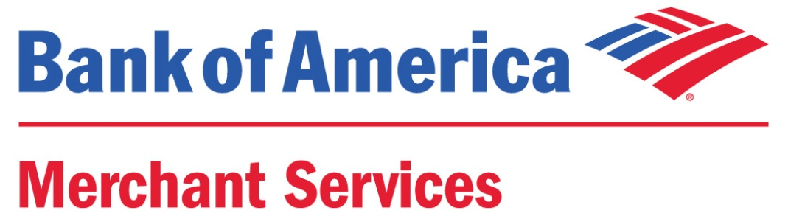
© 2011 Banc of America Merchant Services, LLC. All rights reserved. All trademarks, service marks and trade names referenced in this material are the property of and licensed by their respective owners.
Merchant Services are provided by Bank of America, N.A. and its representative Banc of America Merchant Services, LLC. Banc of America Merchant Services, LLC is not a bank, does not offer bank deposits, and its services are not guaranteed or insured by the FDIC or any other governmental agency.
46

