Slide 1

SHARP Payroll Information
May 22, 2012
Office of General Services, Payroll Services

Slide 2
Welcome
Telephones on mute
Questions can be asked via the instant message area, emailed to nancy.haufler@da.ks.gov or held until the end
Suggestions for future topics
Goals
Open lines of communication across the entire State payroll community
To provide State payroll offices with the tools needed to successfully process payroll for their agency
To share tips and tricks and best practices for processing payroll

Slide 3
Topics
Overview of Department of Administration reorganization and contacts
Efficiencies in Payroll Processing
Fiscal Year End
SHARP Upgrade
Payroll Calculation Tool
KPAYGL5C
Payroll Services Contacts
Q&A

Slide 4
Presenters
Nancy Haufler
Reconciliation and Remittance Team Lead
Nancy Ruoff
Payroll Services Manager
Earl Brynds
Systems Team Lead
Sunni Zentner
Processing Team Lead

Slide 5
Department of Administration
Reorganization and Contacts

Slide 6
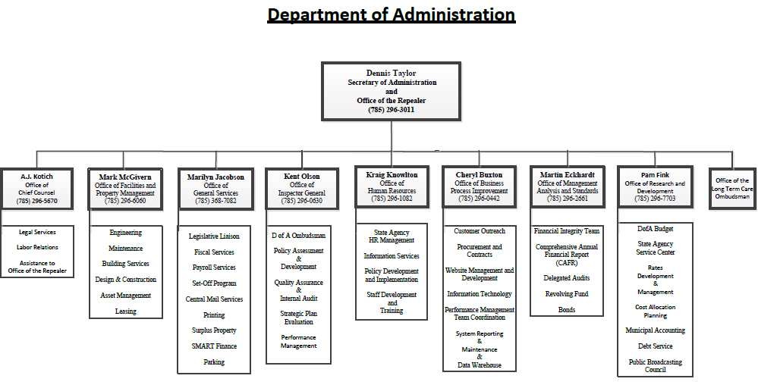
Reorganization and Contacts

Slide 7
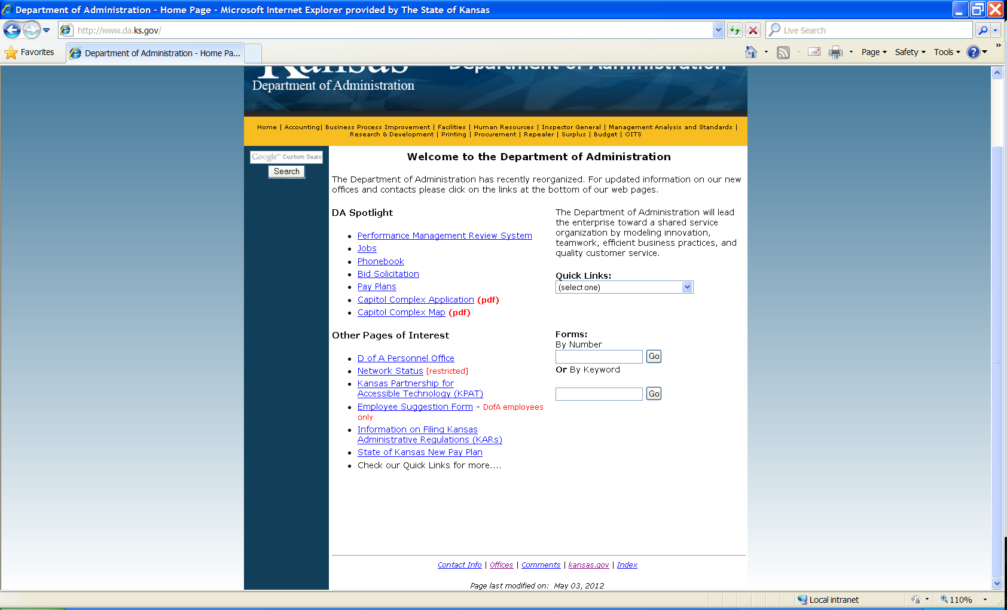
Reorganization and Contacts
www.da.ks.gov

Slide 8
Reorganization and Contacts
Department of Administration website:
http://www.da.ks.gov/
Contact Info link
  list of Offices, Directors and Contact phone numbers
Offices link
  list of Divisions as of January 2011 compared to Offices as of January 2012
Offices Links
  link directly to Office websites

Slide 9
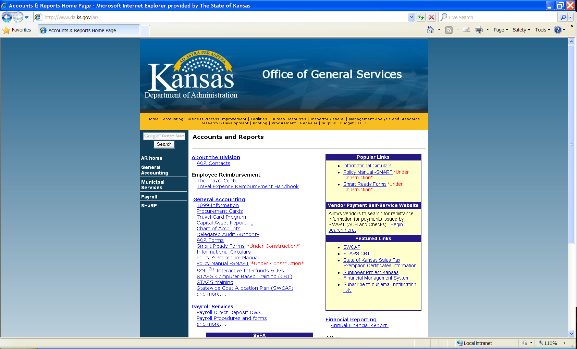
Reorganization and Contacts
www.da.ks.gov/ar

Slide 10
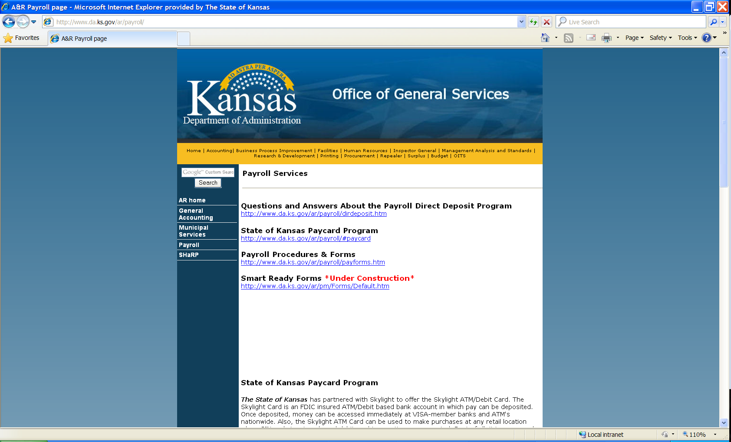
Reorganization and Contacts
www.da.ks.gov/ar/payroll

Slide 11
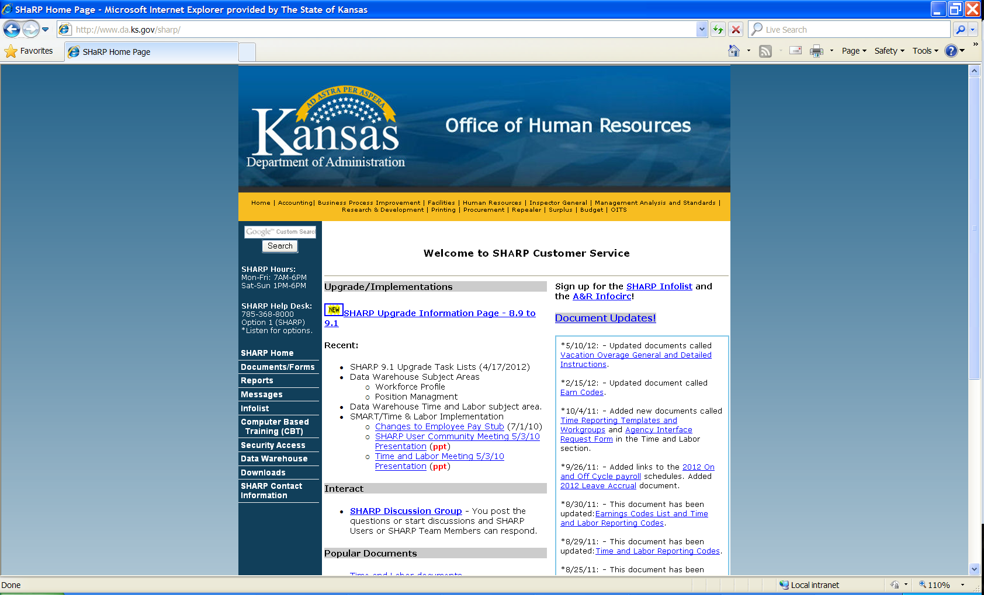
Reorganization and Contacts
www.da.ks.gov/sharp

Slide 12
Reorganization and Contacts
Office of General Services
http://www.da.ks.gov/ar/
Informational Circulars
Payroll – Payroll Services – http://www.da.ks.gov/ar/payroll/
  Direct Deposit
  Paycard
  Procedures and Forms
  SMART Ready Forms
SHARP – http://www.da.ks.gov/sharp/
  SHARP Upgrade Information
  Sign up for SHARP Infolist and A&R Infocirc
  SHARP help desk phone number: 785-368-8000
    Option 1 – Time and Labor
    Option 2 – Payroll
    Option 3 – Human Resources
    Option 4 – Security
  SHARP Contact Information

Slide 13
Efficiencies in Payroll

Slide 14
Efficiencies in Payroll
As a State, we are working toward meeting ‘best-in-class’ metrics for Payroll processing
Thank you for your efforts to assist in meeting or exceeding the following metrics:
  100% Electronic Payroll (Direct Deposit + Paycard)
  96% Paperless pay advice distribution

Slide 15
Efficiencies in Payroll
Current focus is on reduction of off-cycle adjustment transactions
Seeking agency assistance to make this a Statewide Effort
Provides cost savings by reducing staff/system time required to process adjustments
Increases employee satisfaction by generating payroll payments correctly the first time

Slide 16
Efficiencies in Payroll
For ‘best in class’ payroll organizations, only .012% of payments are processed as off-cycle payments
For calendar year 2011 State of Kansas (including regent agencies) processed 15,419 off-cycle payments
This represents 7.2% of all payroll payments in 2011
Total number of off-cycle payments was down from 17,105 in 2010

Slide 17
Processing – Tips & Tricks
Prior to Pay-Calc:
Encourage employees and timekeepers to turn in timesheets and complete time entry as early as possible
  Send a reminder e-mail or give a verbal reminder to all staff members on day timesheets are due if late timesheets are an issue
Encourage employees to submit paperwork for payroll- affecting changes in a timely manner
  Work proactively with HR/Employees to encourage timely submission and entry of changes (i.e. add new dependents)

Slide 18
Processing – Tips & Tricks
Prior to Pay-Calc:
Work collaboratively between HR/Payroll staff to identify, review and validate high-risk areas and transactions for pay period
  Use agency ‘Hot Sheet’ to document changes to review. Confirm the changes were entered correctly to ensure error-free processing by reviewing employee’s check during pre-calc.
  Review and modify internal business processes to allow for more timely entry of changes

Slide 19
Processing – Tips & Tricks
Sample Agency “Hot Sheet”
Courtesy of HR/Payroll staff at SRS

Slide 20
Processing – Tips & Tricks
During Pay Calc Week:
Utilize payroll pre-calcs to help identify and correct errors prior to payroll confirm by reviewing the following:
  On-Line Payroll Error Messages
  On-Line Time Entry Errors
  PAY010 report (Employees Not Processed)
  PAY008 report (Deductions Not Taken)
  PAY002 (Payroll Register) - Compare to prior period
  PAY007 (Arrearages)
If your agency needs assistance accessing CoreFTP to obtain payroll reports please contact Payroll Services

Slide 21
Processing – Tips & Tricks
During Pay Calc Week:
Ensure all employees are set up to receive Direct Deposit or have been signed up for a paycard
Reminder: If an employee has multiple direct deposit accounts, the last record must have a Deposit Type of “Balance”
New Paycard contact in Payroll Services is Amanda.Entress@da.ks.gov or (785) 296-3887

Slide 22
Processing – Tips & Tricks
Following Final Pay Calc and Confirm:
Download and review final payroll reports and files for agency records
Reminder: Payroll reports and files are only available for 30 days through CoreFTP
Identify any errors in final pay calc that require payroll adjustments to be processed

Slide 23
Processing – Tips & Tricks
Following Final Pay Calc and Confirm:
Download and review PAY007 Deductions in Arrears Report on Tuesday of pay week
Review arrearages included on report and take appropriate action to collect arrearage
  Confirm arrearage deduction is taken on the employee’s next on-cycle paycheck
  If Deduction Override is in place, confirm override amount will allow arrearage collection to be completed within current calendar year
  If individual is no longer employed with SOK, initiate action to recover arrearage through personal reimbursement

Slide 24
Processing – Tips & Tricks
Worker’s Compensation & KPERS/GTL
Designated Agent Memo dated 5/4/10 instituted new policy regarding KPERS eligibility for individuals receiving workers compensation
Per recent clarification from KPERS, any individual who does not receive at least 50% of their regular bi-weekly rate of pay from a combination of regular, vacation, and sick leave and who has not been attending work for ten days or more is no longer in a KPERS eligible position

Slide 25
Processing – Tips & Tricks
Worker’s Compensation & KPERS/GTL
For employees in this situation, agencies should
  Stop KPERS deductions for the employee with an effective date of the first day of the first pay period after the employee has ceased to receive 50% of their regular bi-weekly rate
  Stop GTL deductions for the employee with the same effective date as the KPERS deduction
  Complete the KPERS-60 Employer’s Report of Disability in order to ensure continued group-term life insurance coverage for the employee while they are on short-term disability
Please ensure all steps are completed as agencies have been inconsistent in stopping the GTL deductions which can have an impact on an employee’s calculated amount for taxable group life insurance

Slide 26
Efficiencies in Payroll
Garnishment Information and Tips
Garnishment information is available to all agency payroll staff with access to view a paycheck in SHaRP.
  The information can be used by agencies to help employees who have questions about their garnishments or need paychecks printed out with garnishment information included.
  This is the same information available to Payroll Services staff in regards to what an employee has on their paycheck related to garnishments.

Slide 27
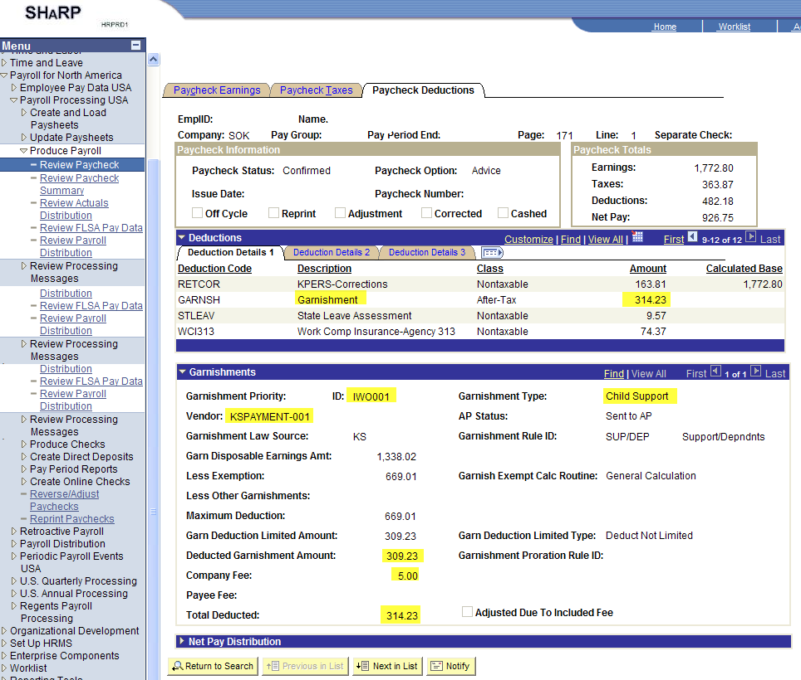
Efficiencies in Payroll
Example, from Paycheck Deductions:

Slide 28
Efficiencies in Payroll
The information is located at Payroll for North America > Payroll Processing USA > Produce Payroll > Review Paycheck.
Once you enter the EmplID and requested Pay Period End Date, go to the Paycheck Deductions tab and click on the blue line that says Garnishments. The box will open up and each garnishment can be viewed one at a time, or click the View All button and see what was taken on different garnishments.
Employees typically want to know what garnishments are taken, the amounts taken for each garnishment, and where the amount is being sent. This box shows the Deducted Garnishment Amount, the amount of fee taken, if any, and also the Vendor the payment was remitted to.
The amounts located in the Garnishment section will tie to the total amount deducted for the GARNSH deduction code.

Slide 29
Arrearage Balances

Slide 30
Arrearage Balances
In recent months, Payroll Services has sent information to agencies with outstanding arrearage balances encouraging a 75% reduction of the balances. Thank you to the agencies who took action and accomplished a successful and significant reduction!

Slide 31
Arrearage Balances
On-going suggestions to avoid large outstanding arrearage balances:
Download and review PAY007 Deductions in Arrears Report regularly.
  Generated after every SHARP off-cycle
Review arrearages included on report and take appropriate action to collect arrearage
  For each arrearage listed, make notes regarding what kind of transaction created the arrearage and retain for future reference. (Example: GHI for PPED xx/xx/xxxx.)
  If the employee is still earning wages and is paid regularly, check future payrolls. Make sure the arrearage is collected, and the amount is appropriate so that the entire arrearage balance is collected by the end of the calendar year.

Slide 32
Arrearage Balances
  The General Deduction Override page can be used to create a maximum collection amount for each paycheck.
  If the employee is no longer employed or is not earning wages, start collection procedures immediately.
    Example: Send the individual a letter with an explanation of the debt, the amount owed, and a deadline or schedule for paying.
  If the arrearage is collected by personal reimbursement, agencies should submit a DA-180 form with a copy of the receipt voucher to Joyce.Dickerson@da.ks.gov in Payroll Services so that the personal reimbursement will be recorded to satisfy the arrearage amount.

Slide 33
Arrearage Balances
  If the arrearage is determined to be uncollectible and is delinquent, please follow the procedures in Informational Circular 00-P-020, submitting the debt to Setoff.
  Arrearage balances that have been submitted to Setoff will be removed from the arrearage balances in SHARP by Payroll Services. If the agency has previously submitted an arrearage balance to Setoff and the balance still remains on the PAY007 report, please submit the documentation to Amanda.Entress@da.ks.gov in order for the arrearage balance to be removed.

Slide 34
Arrearage Balances
Balances should generally not go uncollected for over six months unless the circumstances are unusual.
Please communicate with Payroll Services if you need assistance with an arrearage balance that is over 5 years old and details for the transaction that generated the arrearage are not available.

Slide 35
Fiscal Year End

Slide 36
Fiscal Year End
Fiscal Year End
The last on-cycle paycheck for FY12 is for the pay period 5/27/12 to 6/9/12 paid on 6/22/12
The last off-cycle paycheck for FY12 will be processed 6/25/12 paid on 6/28/12 for the 6/9/12 PPED . Note: This will be the last opportunity to process a paycheck adjustment charged to FY12 expenditures
The process to create new FY13 funding rows in the Department Budget tables will be run during the batch cycle the night of June 17, 2012. The new FY13 row will have an effective date of 6/10/12. Agencies should not enter any rows in the Department Budget tables with an effective date greater than or equal to 6/10/12 until after the FY13 insert has been completed

Slide 37
Fiscal Year End
Fiscal Year End (continued)
Refer to OGS Payroll informational circular 12-P-027 published on May 15, 2012 for more information regarding FY12 year end payroll processing
Another OGS Payroll informational circular regarding FY13 payroll contribution rates will be issued as soon as the information becomes available
Reminder: the current KPERS death and disability insurance contributions moratorium will expire after the end of the fiscal year. Beginning with on-cycle paychecks dated July 6, 2012, the employer portion of KPERS death and disability insurance contributions will be collected and remitted again by Payroll services

Slide 38
SHARP Upgrade

Slide 39
SHARP Upgrade
SHARP Upgrade
Primary Reasons for Upgrade:
Extended support for Oracle PeopleSoft Enterprise 8.9 ends December 31, 2012. Under current support schedules, upgrading to 9.1 provides the opportunity for extended support through September, 2017
Completes transition of all non-regent State agencies to PeopleSoft Time and Labor
Provides opportunity for increased efficiencies including the ability to issue electronic W-2s
New ‘look and feel’ with PeopleTools upgrade including navigation changes

Slide 40
SHARP UpgradeeopleSoft 9.1 Upgrade Project Timeline
2011 |  |  |  |  |  |  |  |  |  |  |  | 2012 |  |  |  |  |  |  |  |  |  |  |  | 2013
JAN | FEB | MAR | APR | MAY | JUN | JUL | AUG | SEP | OCT | NOV | DEC | JAN | FEB | MAR | APR | MAY | JUN | JUL | AUG | SEP | OCT | NOV | DEC | JAN | FEB
Build Technical Platform
Configure Environments
Convert to Production
Data Conversions to Environments (Multiple Test Passes)
Fit/Gap
Design, Program, Unit Test
Execute System Test
Deployment Prep
Training Updates/End User Training
Change Management/Communications

Slide 41
SHARP Upgrade
SHARP Upgrade
Current Status:
Working through the second of four scheduled system test cycles. System test is scheduled to be completed by August 14, 2012
Computer Based Training (CBT) materials are being updated to include 9.1 screen shots/navigation. Agencies will be notified when the CBT materials are ready to be used for training
Researching and testing the ability to process non-pay affecting transactions (e.g. changing REG to VAC) in payroll without using the current payroll adjustment process
Agencies should be managing their task list downloaded from the SHARP website at http://www.da.ks.gov/sharp. The Agency task list is a detailed list of transition and deployment related activities for agencies to complete during the months leading up to, during, and beyond go-live that you are responsible to complete. Please monitor, plan ahead and ensure tasks are completed by the end dates as noted on the task list

Slide 42
SHARP Upgrade
SHARP Upgrade
Upcoming Events:
Mock conversions will be processed by technical and functional staff from June 4, 2012 to October 22, 2012
Operational Readiness Testing (ORT) will be conducted by central staff from November 27, 2012 to January 1, 2013 using new agency submitted task files
The next Time and Labor informational meeting will be held Tuesday, September 18, 2012. Further details regarding this meeting will be sent to agencies as the date approaches
Current go-live proposed schedule is for the 8.9 to 9.1 conversion to occur in early February, 2013

Slide 43
Payroll Calculation Tool

Slide 44
Payroll Calculation Tool
A payroll calculation tool was developed to assist employees and agencies with paycheck modeling outside of SHARP.
Employees can easily use the tool to calculate what their paycheck amounts would be using different tax and benefit options. This allows employees to make the best use of their dollars earned.
We strongly encourage agency staff to refer retiring and terminating employees to the tool when trying to determine what tax and benefit options the employee use for their final paycheck.
The tool can be accessed through http://www.kansas.gov/employee/.

Slide 45
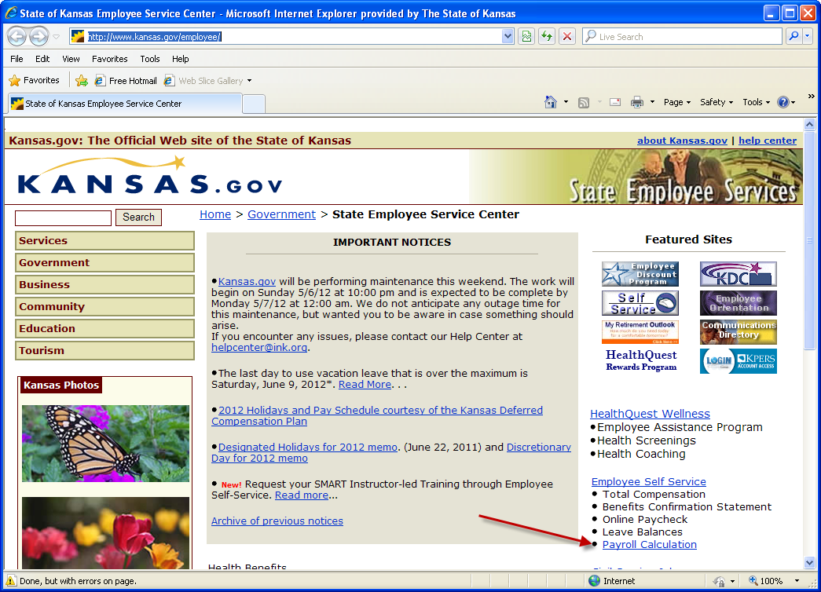
Payroll Calculation Tool

Slide 46
Payroll Calculation Tool
The tool contains three tabs:
  Information – provides basic information about use.
  Data Entry – where the user enters all information necessary for the calculation. It is helpful to have a paycheck stub/screen print for reference.
  Estimated Payroll Calculation – shows the result.
The user can easily navigate between the Data Entry and Estimated Payroll Calculation tabs to change the data entered and view the new calculation.

Slide 47
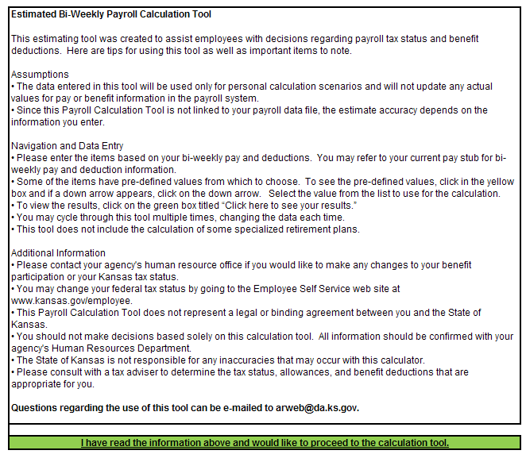
Payroll Calculation Tool

Slide 48
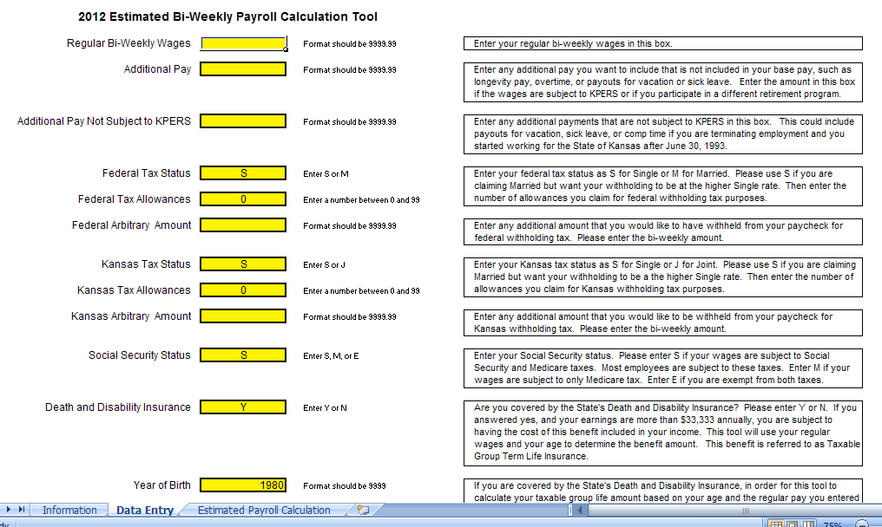
Payroll Calculation Tool

Slide 49
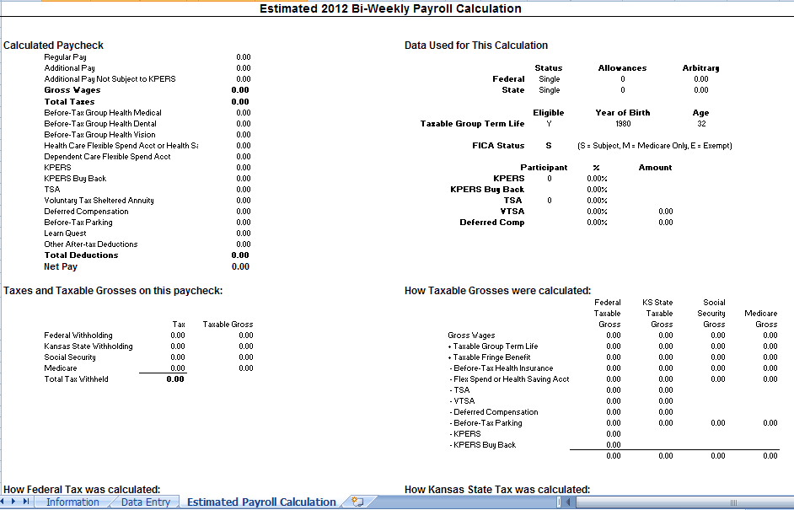
Payroll Calculation Tool

Slide 50
Payroll Calculation Tool
Example 1
Here is the calculation for an employee with the following attributes:
Bi-weekly pay = $2,000
Tax Status Federal = Married, 3 Allowances, State = Joint, 1 Allowance
Deferred Comp = 2%
KPERS = 4%
Date of Birth = January 1, 1972 (Used in the taxable group life computation)
No health insurance

Slide 51
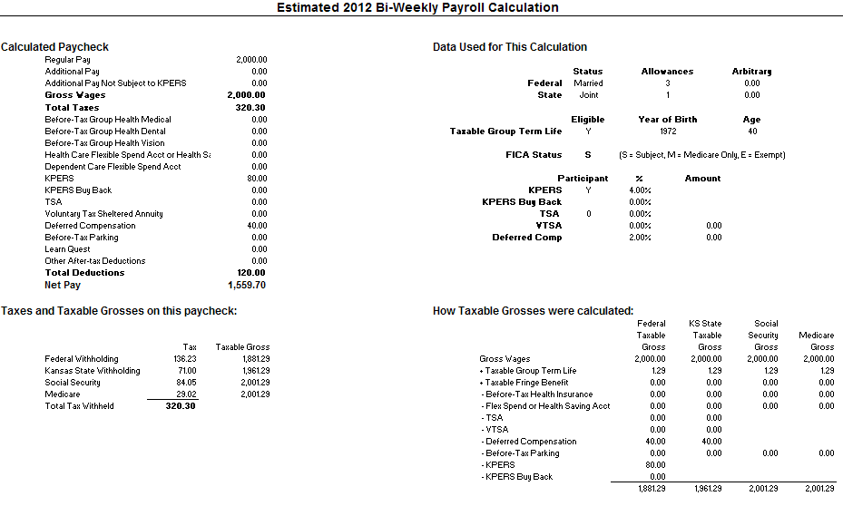
Payroll Calculation Tool

Slide 52
Payroll Calculation Tool
Example 2
Now, the same employee wants to see the following changes:
Longevity Pay = $600
Deferred Comp = $500
Tax Status Federal = Single, 4 Allowances State = Single, 1 Allowance

Slide 53

Payroll Calculation Tool

Slide 54
Payroll Calculation Tool
Example 3
Now, the same employee will be resigning and wants to see the following changes:
Leave Payout = $6,000
Deferred Comp = $3,000
Tax Status Federal = Single, 15 Allowances State = Single, 10 Allowances

Slide 55
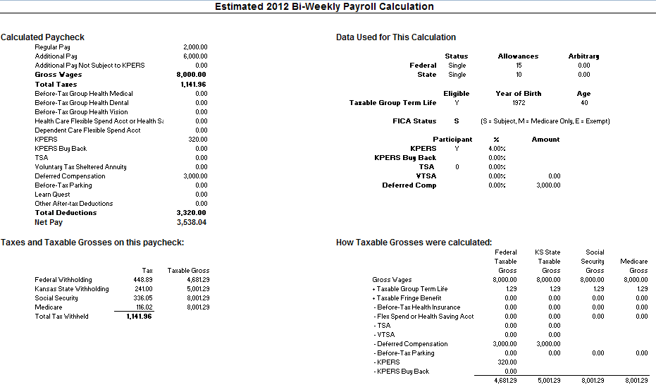
Payroll Calculation Tool

Slide 56
Payroll Calculation Tool
Questions regarding the Payroll Calculation tool can be directed to Sunni.Zentner@da.ks.gov.

Slide 57
KPAYGL5C Report

Slide 58
KPAYGL5C - Background
The SHARP KPAYGL5C is a data file that has existed since 1996, when SHARP was first implemented. Until now, only specific agencies have been receiving this file.
The purpose of this file is to provide agencies with all their payroll charges in a format that can be imported in Excel, Access, or other spreadsheet software.
The layout changed significantly in July, 2010 at the time of the SMART implementation.

Slide 59
KPAYGL5C - Overview
KPAYGL5C is distributed to agencies through Core FTP Pro, similar to other payroll and HR files.
The file is retained in Core FTP Pro for 30 days.
The information reflects the accounting transactions created in SHARP that correspond to every paycheck that is funded by an agency.
When paychecks are split-funded between multiple agencies, program logic splits and sends the funding lines to only the funding agency.

Slide 60
KPAYGL5C – Overview
Journal IDs on the funding lines are the same Journal IDs processed in SMART for payroll.
KPAYGL5C contains the detail rows for the journals that are summarized (by matching chartfields) and sent to SMART.
When funding information is changed in SMART due to journal edit errors or budget errors, these changes are not reflected on the KPAYGL5C.

Slide 61
KPAYGL5C – Timing of Files
KPAYGL5C is created two times each pay period
  Following the on-cycle
  Following the completion of Off-Cycle ‘C’
The timing for this file could be slightly different when holidays alter the processing schedule.

Slide 62
KPAYGL5C – Timing of Files
First File: The weekend of payroll confirm
Example: For the pay period ending April 28th, 2012, the first file was generated on Saturday, May 5th.
The first file does not include Journal IDs since the file is created prior to sending the data to SMART.
The first file includes only on-cycle paychecks.
Some agencies use this first file to get total expenditures for federal funds in order to request federal draw-downs.

Slide 63
KPAYGL5C – Timing of Files
Second File: Two days after Off-Cycle ‘C’ for the pay period
Example: For the pay period ending April 28th, 2012, the second file was generated on Wednesday evening, May 16th. Off-cycle ‘C’ was processed on Monday night, May 14th.
This file includes all activity for the pay period. It includes all transactions for the on-cycle and off-cycles A, B, and C.
Journal ID is included for all transactions.

Slide 64
KPAYGL5C – File Versions
Older Version:
Generated in a flat file format.
Does not contain column labels on the top row of the file.
Contains ALL accounting transactions, including expenditure, liability, and cash rows.
Contains every data field that is on the payroll accounting table, including many fields that are empty, and some fields that are not needed for agency use.
Many agencies using this version of the file have created macros in Excel to open and format the file, and even to eliminate some of the fields they don’t need.
Opening the file manually using Excel can be tedious. It is helpful to have the file layout to refer to in order to determine where column breaks need to be inserted.

Slide 65
KPAYGL5C – File Versions
Newer Version:
Generated in a comma delimited (CSV) file format.
Contains column labels in the top row for each data element.
Contains only expenditure accounting transactions.
Contains a subset of the data fields from the payroll accounting table. The fields that were eliminated in this version of the file were fields typically not needed by agencies.
Simple to open using Excel. Since the file is comma delimited, column dividers are inserted automatically.

Slide 66
KPAYGL5C – Roll-Out
Roll-out for new agencies is May 17th
Agencies previously not receiving this file will begin receiving it May 17th in the newer CSV format.
The new file appearing in Core FTP Pro on May 17th was processed during the May 16th SHARP batch cycle. This report includes all payroll expenditures for the PPED 4/28/2012.
Agencies receiving KPAYGL5C prior to May 17th will continue to receive it in the format previously selected by the agency.
Any agency receiving the older version may request to switch to the CSV version of the file.

Slide 67
KPAYGL5C – Use of File
Suggested uses for the KPAYGL5C:
Information from the on-cycle payroll file can be used to help determine federal drawdown amounts.
Using this file in Excel, Access, or a similar application, agencies can sort, filter, and subtotal for any data element or group of data elements to meet the agency’s financial or budgetary needs.
KPAYGL5C replaces KPAYWAGE to get wage and fringe information by position number for a particular program code/funding source.
Filter information by Project ID to assist with special reporting needs associated with a project or grant.
Accumulate all KPAYGL5C files for the fiscal year to assist with obtaining Fiscal Year-To-Date budget information.

Slide 68
KPAYGL5C - Instructions
The next set of slides shows how to download and open the KPAYGL5C file using Excel.

Slide 69
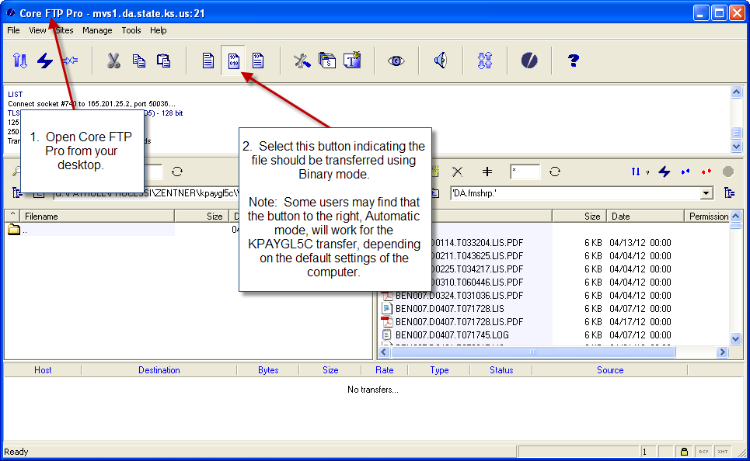
KPAYGL5C - Instructions

Slide 70
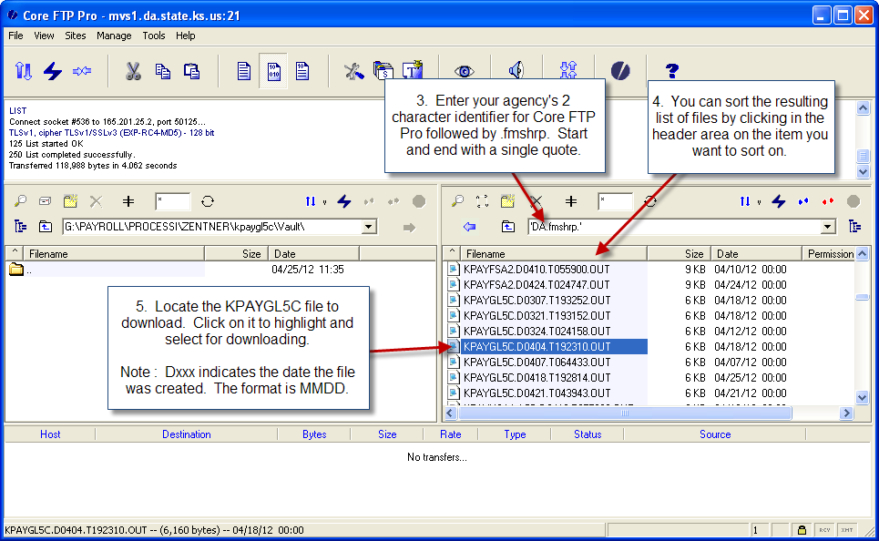
KPAYGL5C - Instructions

Slide 71
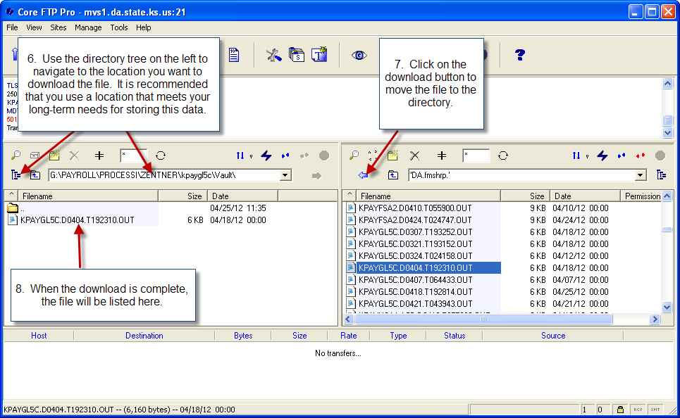
KPAYGL5C - Instructions

Slide 72
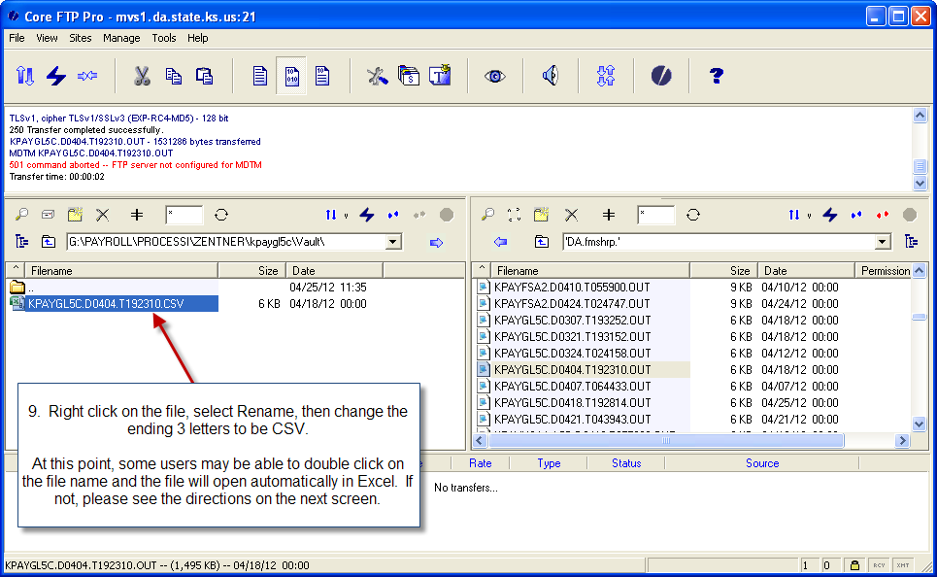
KPAYGL5C - Instructions

Slide 73
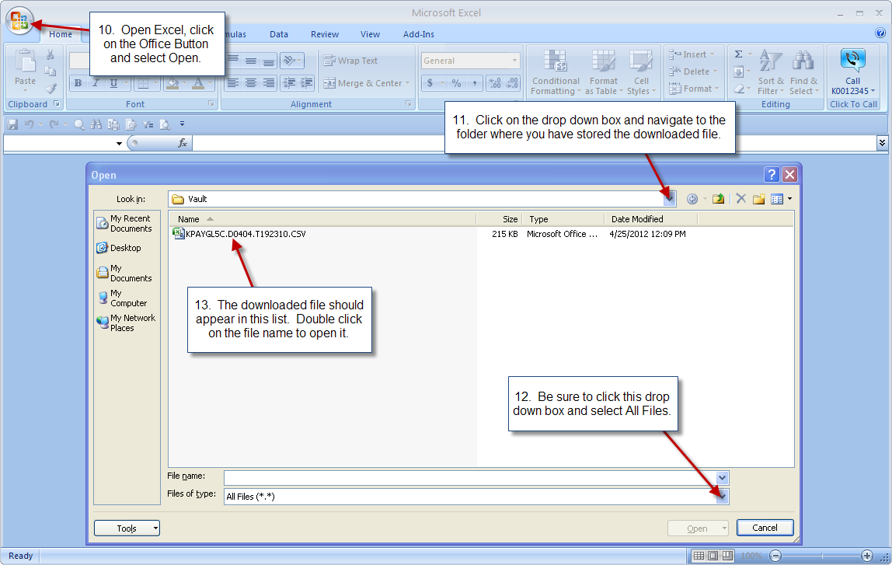
KPAYGL5C - Instructions

Slide 74
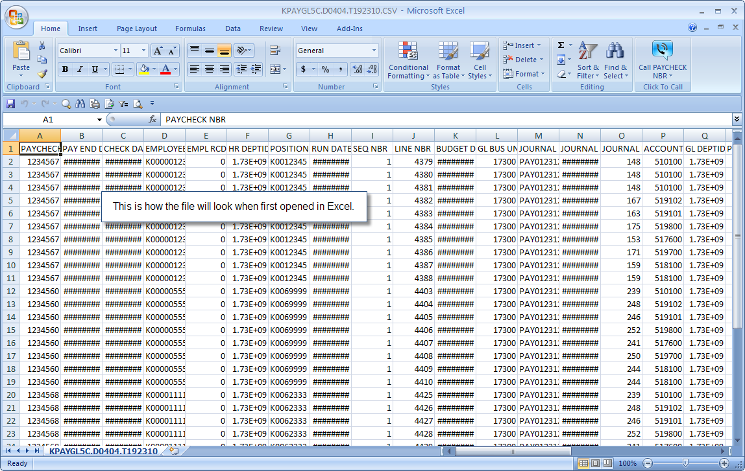
KPAYGL5C - Instructions

Slide 75
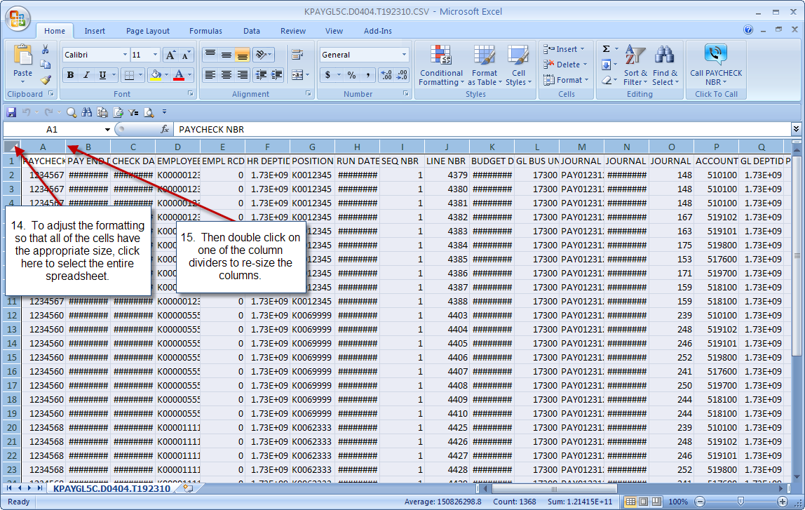
KPAYGL5C - Instructions

Slide 76
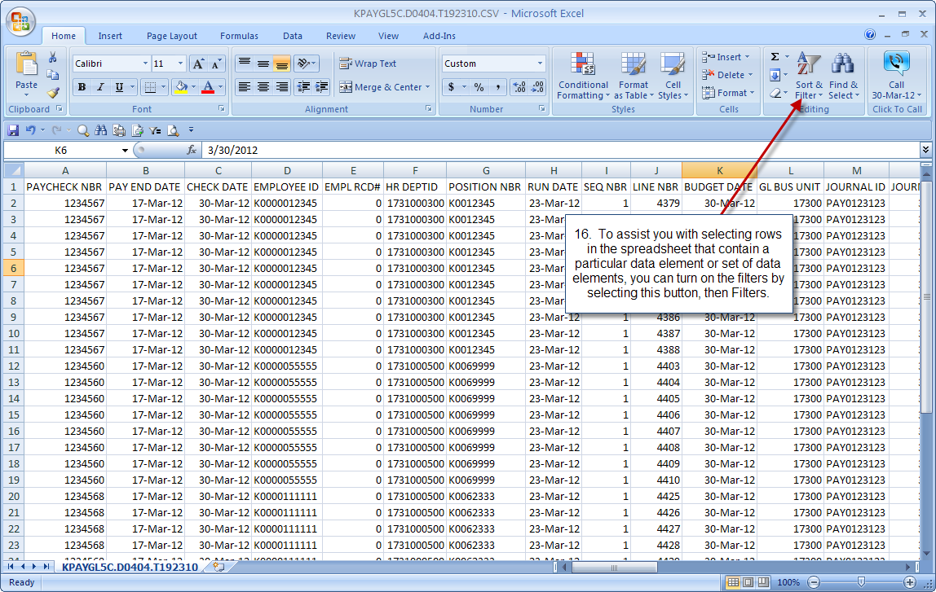
KPAYGL5C - Instructions

Slide 77
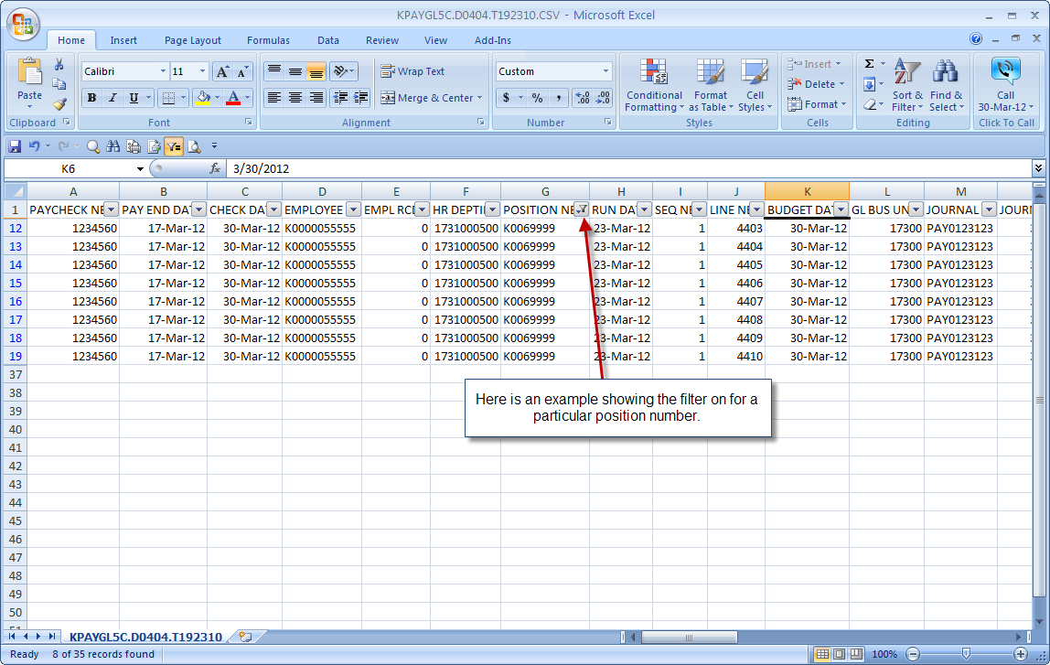
KPAYGL5C - Instructions

Slide 78
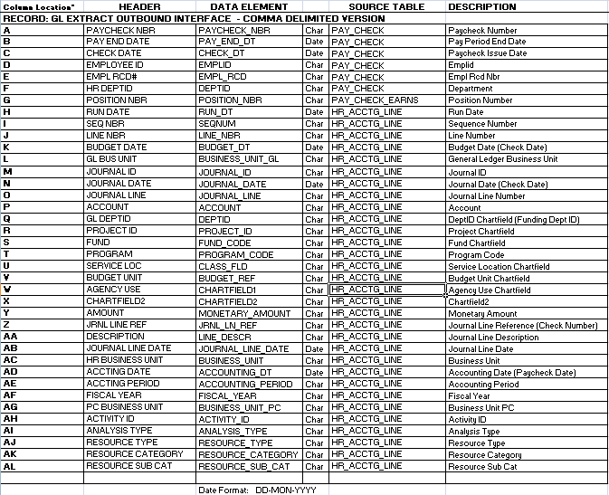
KPAYGL5C – Data Elements

Slide 79
KPAYGL5C – Tips & Tricks
Download the file within 30 days of the date the file was generated. The file will be deleted from Core FTP Pro after 30 days.
Use Outlook to set-up calendar reminders for the days the file needs to be downloaded. Agencies will be billed for special requests to re-generate old pay period files.
Save the original file in a secure location and create a working copy to store in a different folder. Use the working copy for any manipulation of the data.
Accumulate the KPAYGL5C files for fiscal year reporting and budgeting.
Import the file into Access where specific reports can be developed and maintained.

Slide 80
KPAYGL5C – Tips & Tricks
Optional: Track all changes (due to journal/budget errors) that are made to payroll journals in SMART and update KPAYGL5C to reflect those changes.
Optional: Track other journals that are processed in SMART to change funding for payroll expenditures, then add rows to KPAYGL5C for those journals.
Optional: Run query KS_GL_SALARIES_WAGES_EXPENSES in SMART to review/compare all payroll expenditures (account codes 51000-519900). Query results include journals for all expenditures detailed in KPAYGL5C file in addition to any online or spreadsheet journals entered for account codes 510000-519900.
Consider additional Excel or Access training for staff in order to utilize more sophisticated functions for data manipulation.

Slide 81
KPAYGL5C – Info/Contacts
See Office of General Services Informational Circular 12-P-026 located at
http://www.da.ks.gov/ar/infocirc/fy2012/IC12p026.htm
  The informational circular includes a layout of the data elements contained in the file.
Further assistance is available by contacting
  Sunni Zentner, at Sunni.Zentner@da.ks.gov or
  Lisa Kraus, at Lisa.Kraus@da.ks.gov

Slide 82
Payroll Services Contacts
Payroll Services Help Line: 785.368.8000
Payroll Processing – Sunni Zentner:
Sunni.Zentner@da.ks.gov 785.296.7058
Payroll Recon & Remittance – Nancy Haufler:
Nancy.Haufler@da.ks.gov 785.296.5368
Payroll Systems – Earl Brynds:
Earl.Brynds@da.ks.gov 785.296.5376
Payroll Services – Nancy Ruoff:
Nancy.Ruoff@da.ks.gov 785.296.2853

Slide 83
Questions
?

