Slide 1
KHPA: SMART Fund Balance Report using fund 2556 for exhibit purposes
Budget Balance:
From Commitment Control
Cash Balance:
From General Ledger
Month End Balance:
From Cash Balance Report

Slide 2
To generate a fund balance report showing contingent and firm balance similar to the DAFR8101
Several SMART queries and reports need to be run
Query and report results will need to be recorded in an Excel spreadsheet
Balance information will need to be entered or calculated in the spreadsheet.

Slide 3
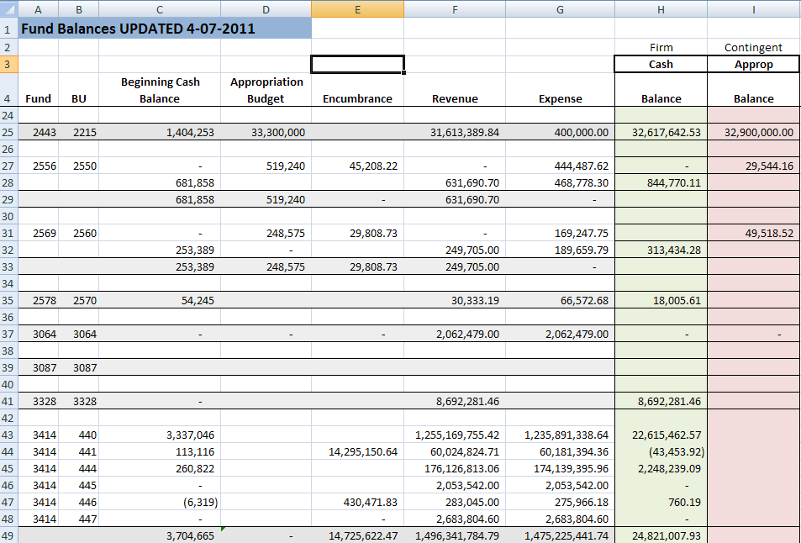
Example
KHPA’s Fund Balance Report
KK

Slide 4
Budget Fund Balance Report (This report shows the budget balance for an appropriated or limited fund.) Reported as contingent balance in KHPA
Run Commitment Control Budget Status Report using Appropriation Ledger Group –
See Attachment A
For Budget Period – Set both the “Value” and “to Value” for current fiscal year. (Can run report for previous fiscal years.)
Remaining Balance on Report = Budget Balance
Appropriation/Limit – Encumbrances – Expenses = Budget Balance

Slide 5
Appropriated Budget Status Ledger Report
(Shows Budget, Encumbrance, Expense against Encumbrance and Remaining Balance)
Remaining Balance = Budget – Encumbrance - Expense
Commitment Control
Budget Reports
Budget Status
Add a New Value
Run Control ID – assign a report name
Unit ID – Agency Number
Ledger Group = CC_Approp
Refresh
Number and check Include CF box
Fund Code 1
Budget Unit 2
Budget Period 3 (Value = 2011 to Value = 2011)
SAVE
RUN
Select format for report
.csv or PDF
OK
Process Monitor
Refresh until:
Run Status = Success
Distribution Status = Posted
Details
View Trace Log
.csv or PDF
Attachment A

Slide 6
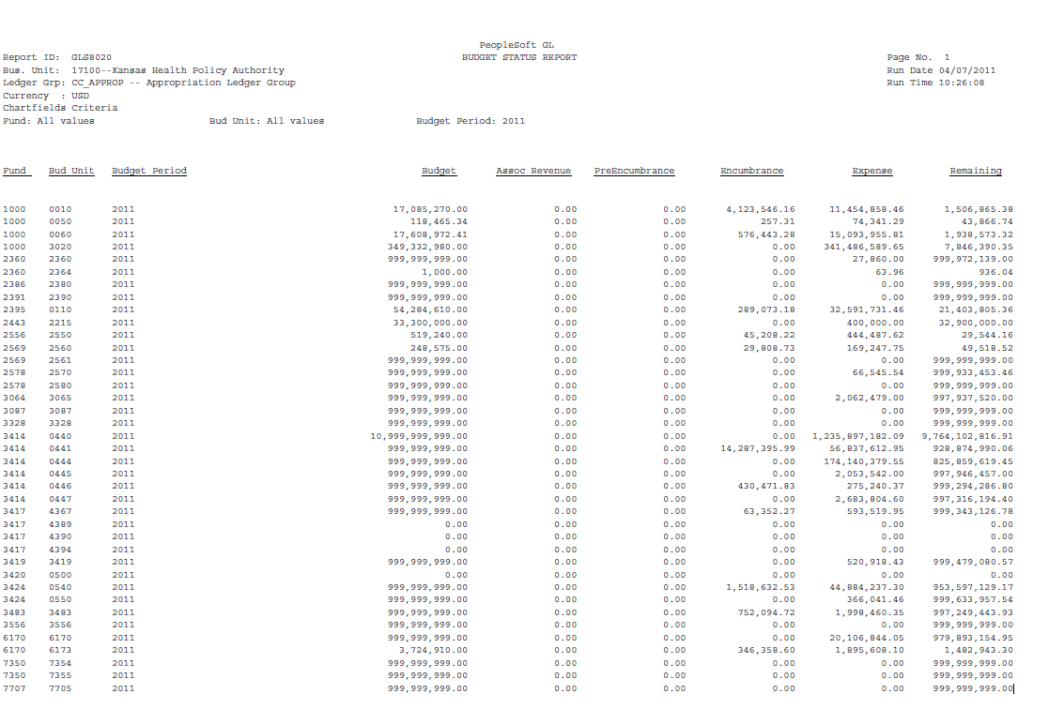

Slide 7
Commitment Control (KK) Fund Balance
quasi Budget Balance
(Shows fund balance after considering all YTD posted and un-posted transactions)
Reported as Firm Balance in KHPA
Run Commitment Control Budget Details report –
See Attachment B
Select “CC_Cash” Ledger
If fund level fund you cannot retrieve information by budget unit
Available Balance includes all posted and un-posted transactions showing a quasi balance fund balance
Does not consider encumbrances or limits
(These do not affect cash balances therefore are not in the cash ledger.)

Slide 8
Budget Detail
(Shows the beginning fund balance under Budget, total fund expenses, total fund revenues and available KK budget.)
KK Available Budget = Begin Fund Balance + collected revenues – processed and not fully processed liabilities
Transactions have been budget checked to make certain money is available.
This is real time information
Commitment Control
Review Budget Activities
Budget Details
Find an Existing Value
Business Unit – Agency number
Ledger Group = CC_CASH
Fund Code:
Budget Unit:
Note: if fund level account cannot pull information by budget unit
Search
Attachment B

Slide 9
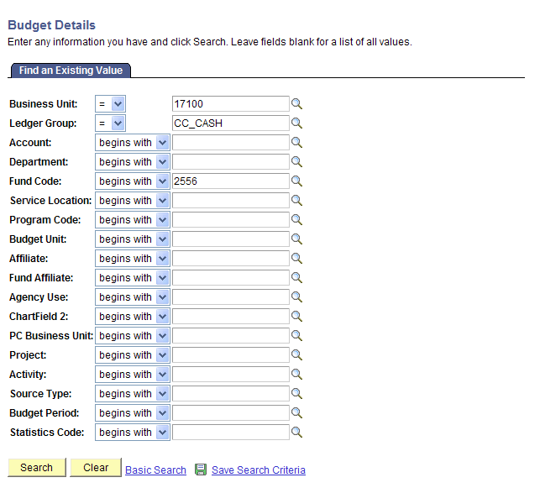

Slide 10
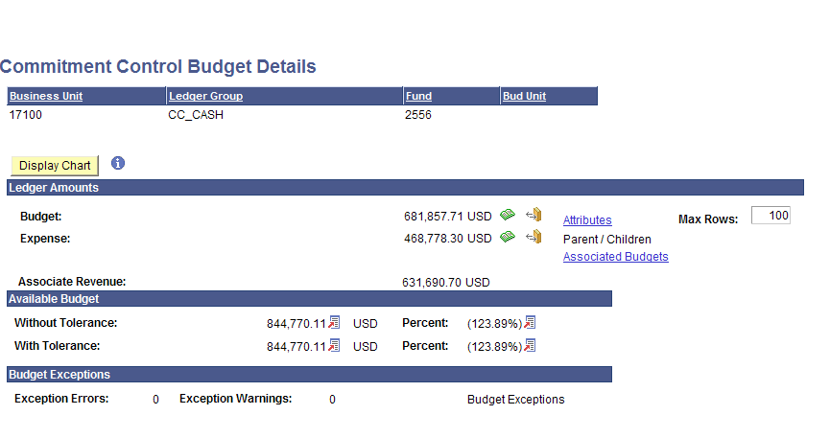
YTD total amount of accounts 5xxxxx and 77xxxx
Beginning Fund Balance = converted STARS balance
KK Fund Balance
YTD total amount of accounts 4xxxxx and 76xxxx
Note: The beginning fund balance will always be the converted STARS balance. It will not change with the new fiscal year.
Expenses and Associated Revenues will continue to be a running total. They do not start over with each new fiscal year.

Slide 11
General Ledger Cash Balance
(This report shows the General Ledger fund balance as of EOB prior business day)
Run Ledger Inquiry for year-to-date fund balance –
See Attachment C
Use “Actuals” ledger
Check “Show YTD Balance” box
Use Account “110100”
If fund level fund cannot pull information by budget unit
Amount shown = general ledger fund balance

Slide 12
Ledger Inquiry
(Shows the general ledger fund balance.)
GL Fund Balance = Begin Balance + revenues – completed expense transactions
Information as of EOB previous day
General Ledger
Review Financial Information
Ledger
Add a New Value
Inquiry Name: (example: balance)
Add
Ledger Criteria
Unit: agency number
Ledger: Actuals
Fiscal Year: 2011
From Period: 1
To Period: current accounting period
Show YTD Balance
Max Ledger Rows: 300
Account: 110100 - check the “Sum By” box
Fund: can enter fund number or leave blank for all funds
Budget Unit: can enter or leave blank for all units
Note: if fund level fund cannot pull information by budget unit
Search
Amount = current fund balance in the general ledger
Attachment C

Slide 13
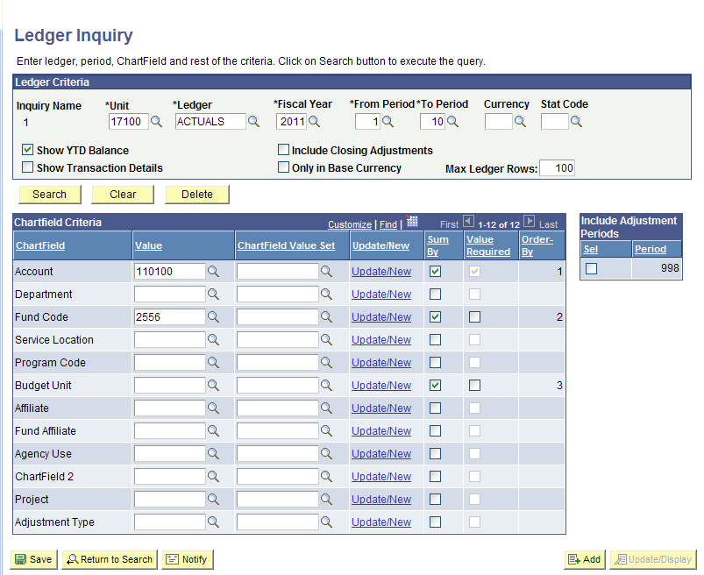

Slide 14
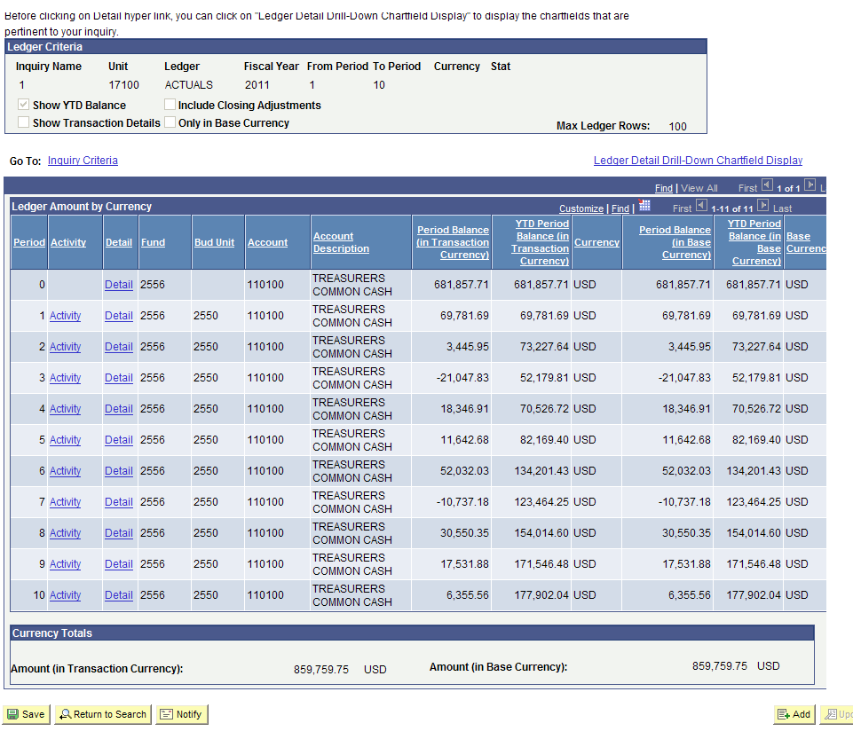
General Ledger
Balance

Slide 15
End of Month Fund Reconciliation
Run SMART query KS_GL_JOURNALS_BYFUND to obtain information on all transactions posted to fund in the general ledger for the month –
See Attachment D
Run General Ledger Cash Balance Report for the month –
See Attachment E
The total of all revenues posted to the fund for the month should equal “Total Source of Funds” on the Cash Balance Report
The total of all expenses posted to the fund for the month should equal “Total Use of Funds” on the Cash Balance Report
The total of all “2” account codes should equal “Accounts Payable” on the Cash Balance Report
The total of all “1403xx” account codes should equal “Prepaid” on the Cash Balance Report.

Slide 16
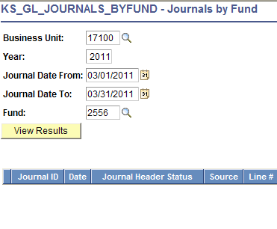
Transaction File = KS_GL-JOURNALS_BYFUND
Reporting Tools
Query
Query Viewer
KS
KS_GL_JOURNALS_BYFUND
Business Unit:
Year:
Journal Date From:
Journal Date To:
Fund:
Search
Sort and total data by Account
110100 - Treasurers Cash
140300 - Prepaid Expenses
220100 - Accounts Payable
4xxxxx - Revenues
5xxxxx - Expenses
7xxxxx - Transfers
Attachment D

Slide 17
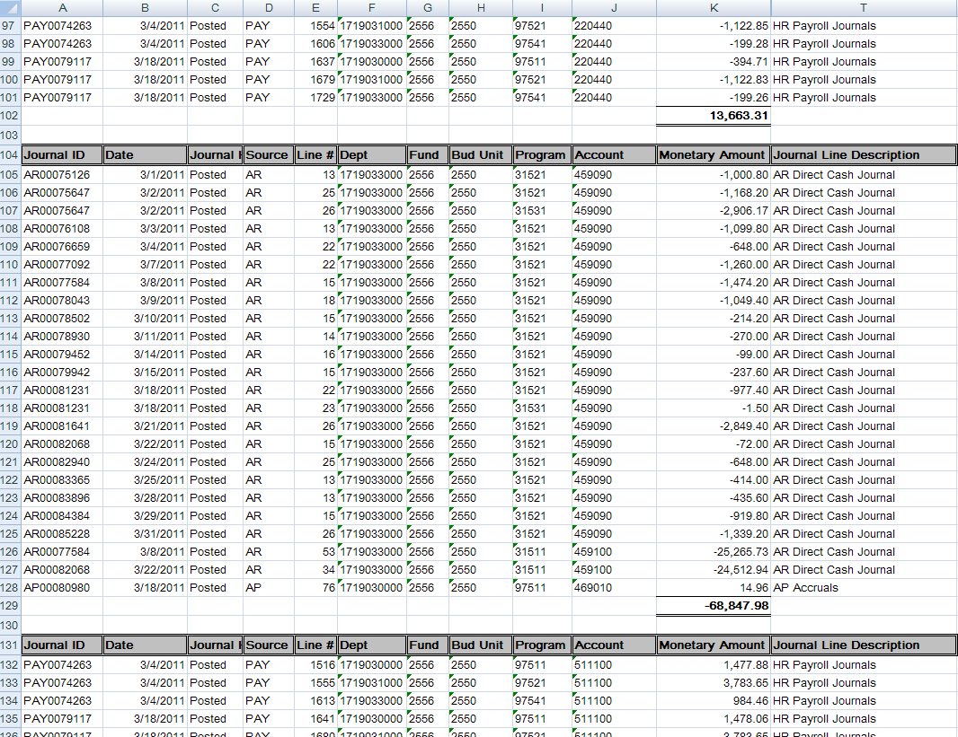

Slide 18
EOM Cash Balance Report – KGL00001
General Ledger
General Reports
Cash Balance Report
Add a New Value – name Run Control ID
ADD
Business Unit = agency #
Fiscal Year = 2011
Range From Accounting Period: enter number for accounting period for report
Range To Accounting Period: enter number for accounting period for report
Fund Code –leave blank for all funds report
Budget Unit – leave blank to include all budget units
Include all Budget Units – DO NOT CHECK THIS BOX
Level 4
Run
OK
Process Monitor
Refresh
Success
Posted
Details
View Log/Trace
.PDF
Attachment E

Slide 19
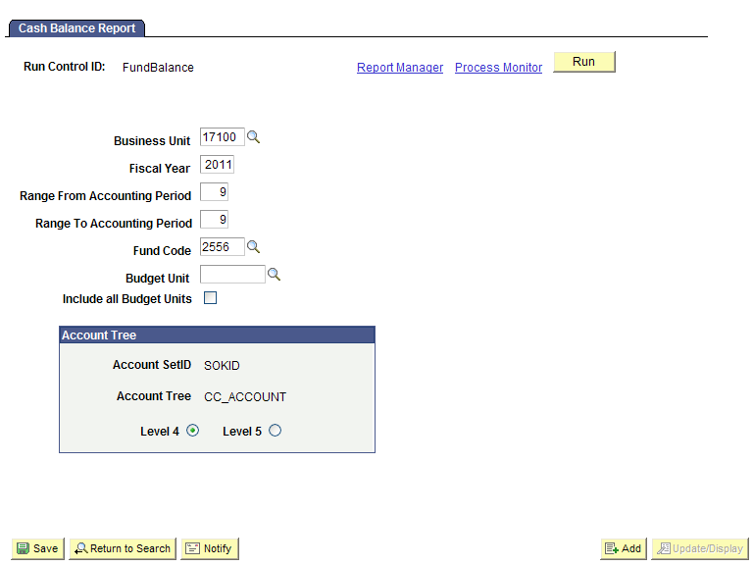

Slide 20
Last month’s ending balance = this month’s beginning balance
Total 4xxxxx
Total 5xxxxx
Total 2xxxxx
Total 1403xx

